Slide 1
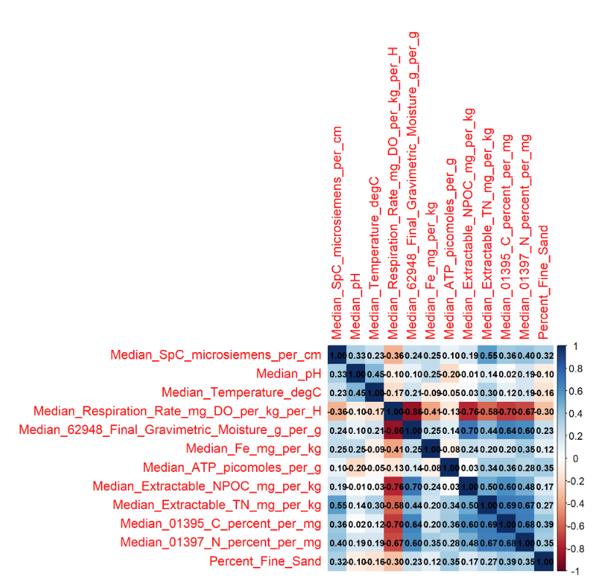
Pearson Correlations
print(vif_values)
Median_pH
1.504789
Median_Temperature_degC
1.693071
Median_Respiration_Rate_mg_DO_per_kg_per_H
7.122208
Median_62948_Final_Gravimetric_Moisture_g_per_g
4.846370
Median_Fe_mg_per_kg
1.557515
Median_ATP_picomoles_per_g
1.485265
Median_Extractable_NPOC_mg_per_kg
2.899635
Median_Extractable_TN_mg_per_kg
2.883096
Median_01395_C_percent_per_mg
3.113812
Median_01397_N_percent_per_mg
2.682878
Percent_Fine_Sand
1.366445

Slide 2
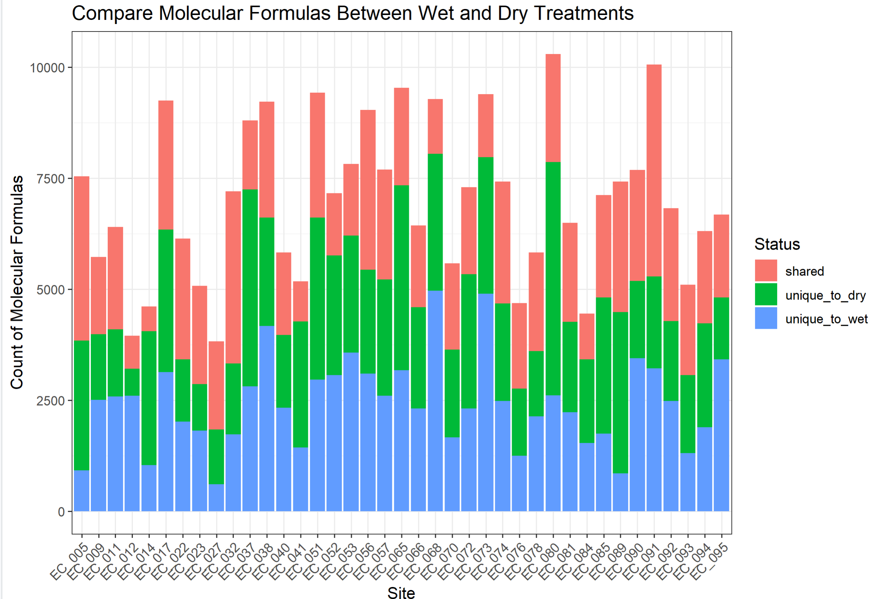
SI figure currently on Molecular_Formulas_per_site_per_treatment script

Slide 3
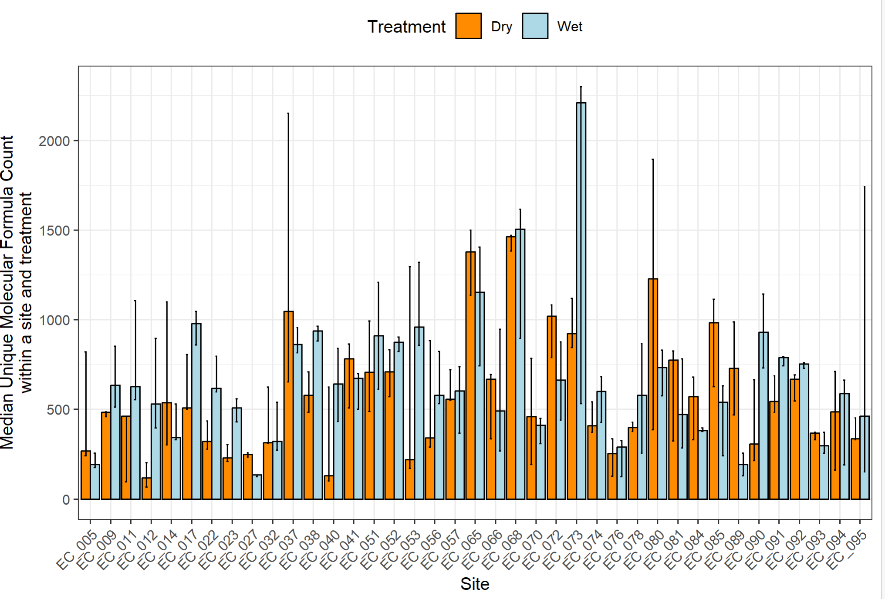
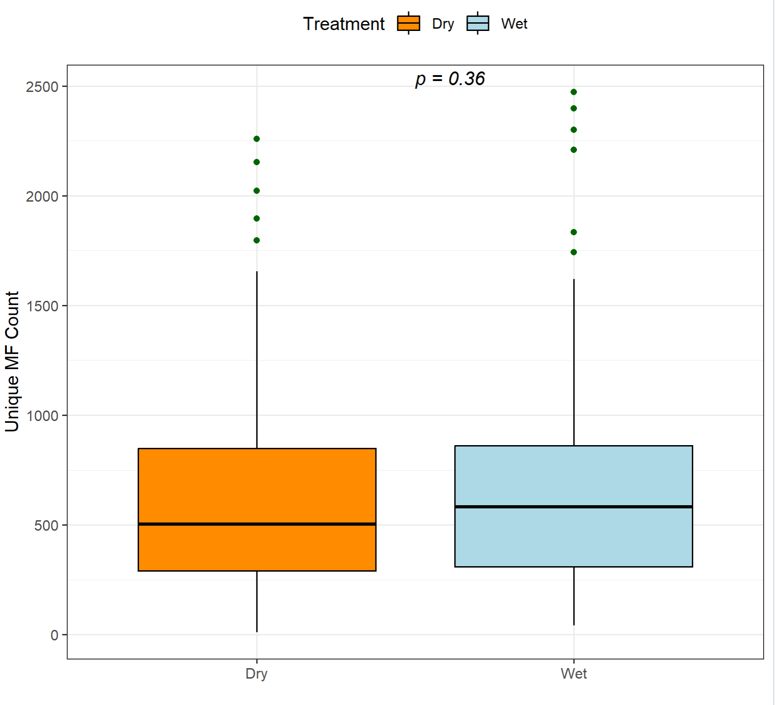
currently on Molecular_Formulas_per_site_per_treatment script

Slide 4
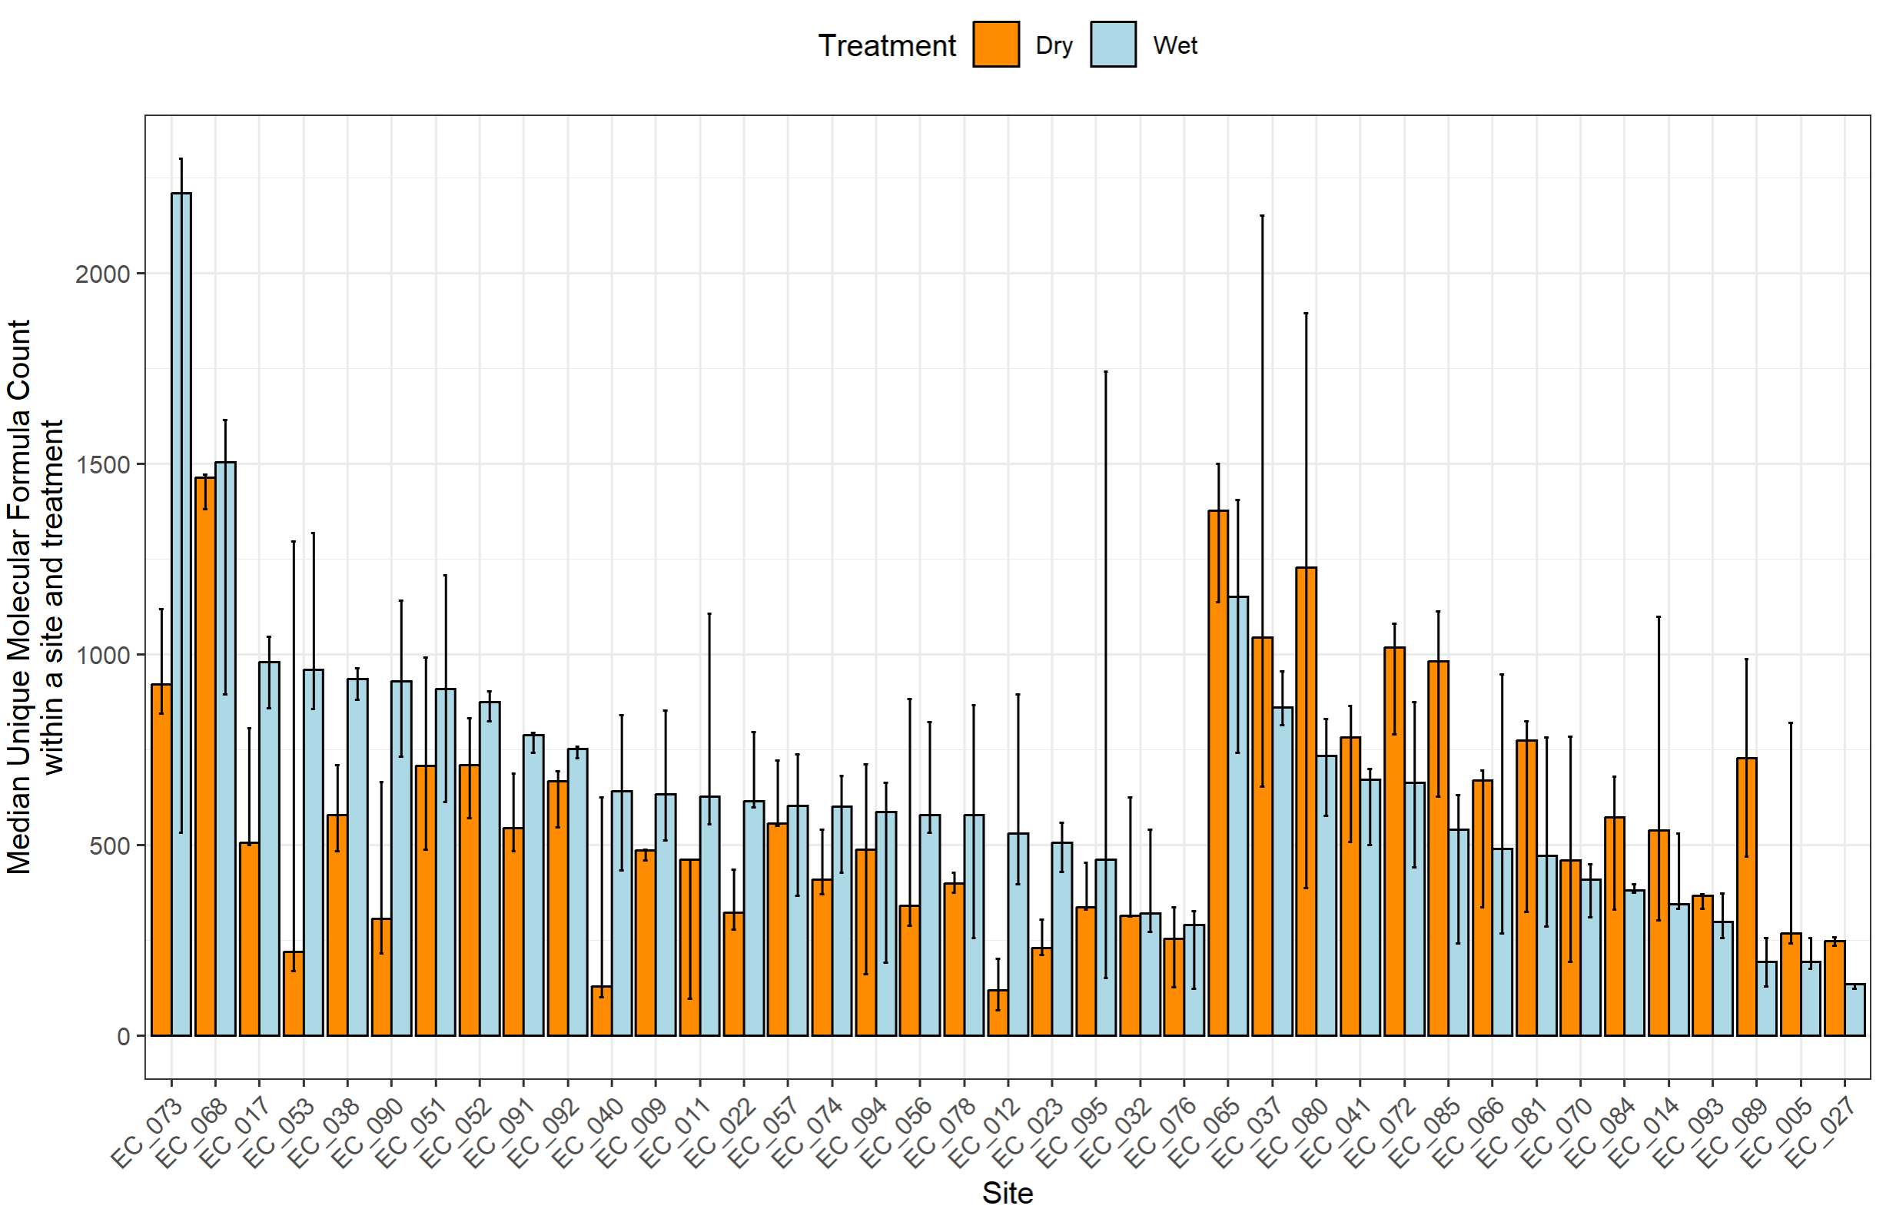
currently on Molecular_Formulas_per_site_per_treatment script
Higher median unique formula count in wet treatment
Higher median unique formula count in dry treatment

Slide 5
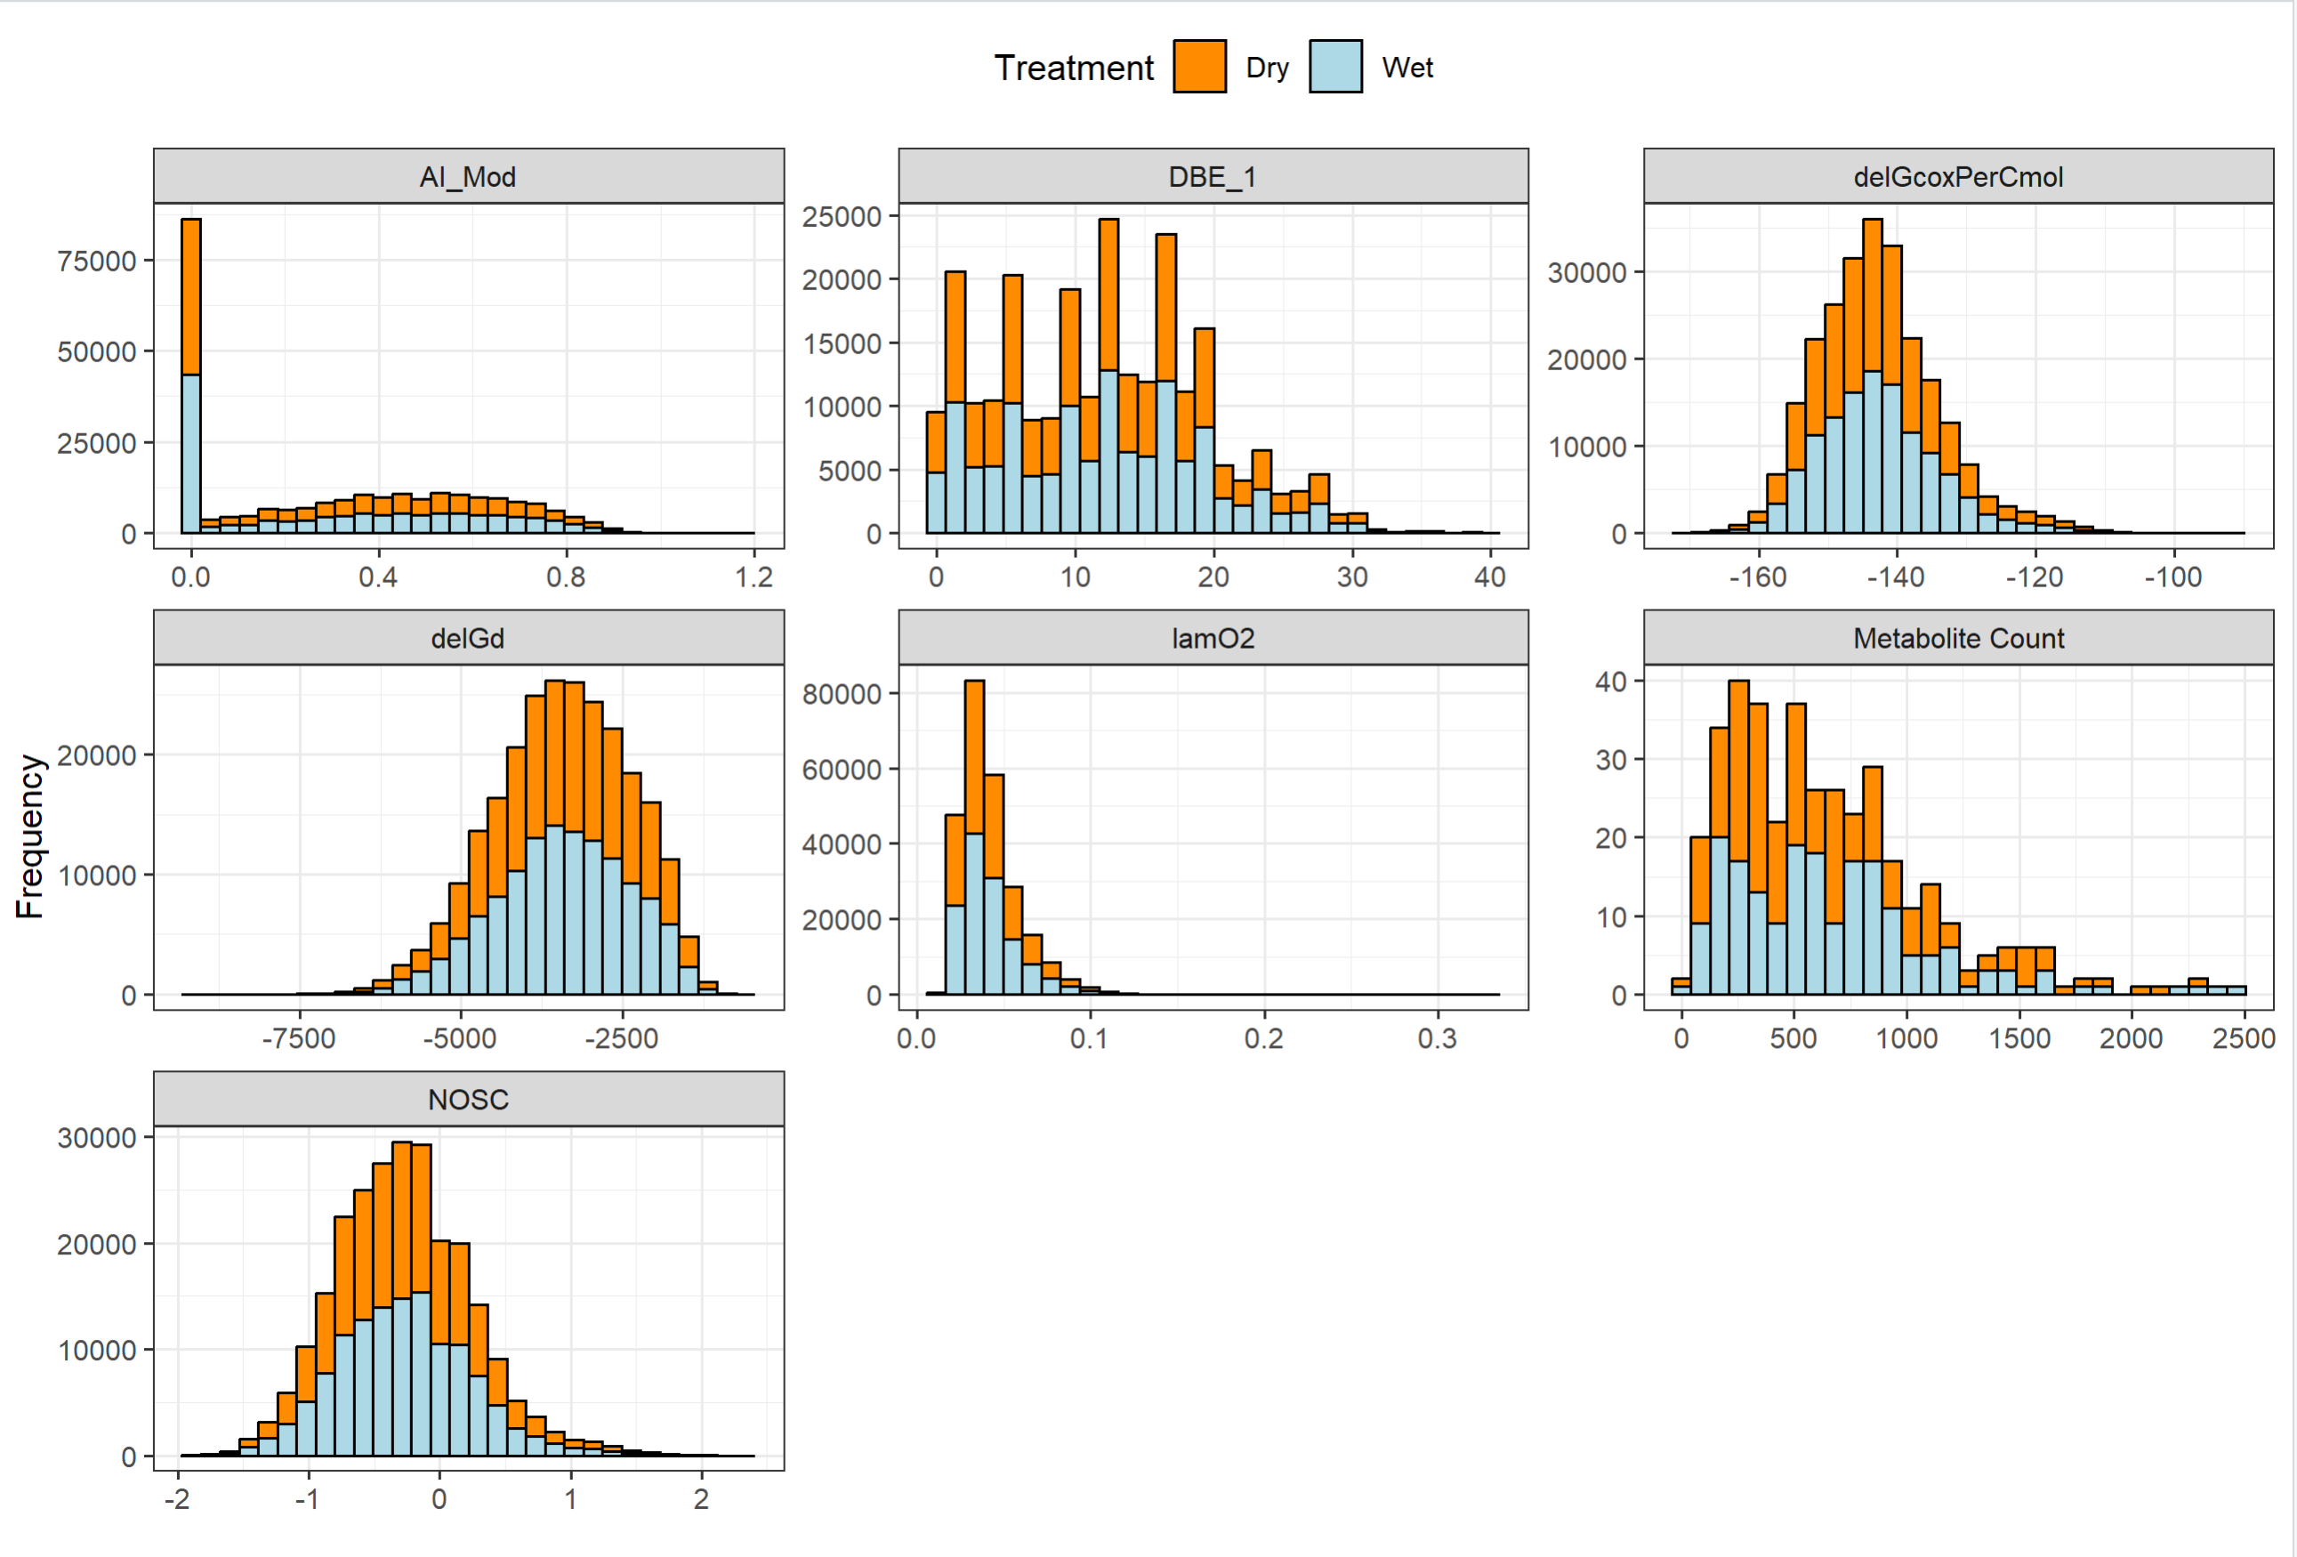
SI figure currently on Histograms_Overall_Unique_Formulas
Notes:
Note that I made this figure for group one and group 2 and it should the same, no overall differences in the broad categories of chemistry within each group just the metabolite count

Slide 6
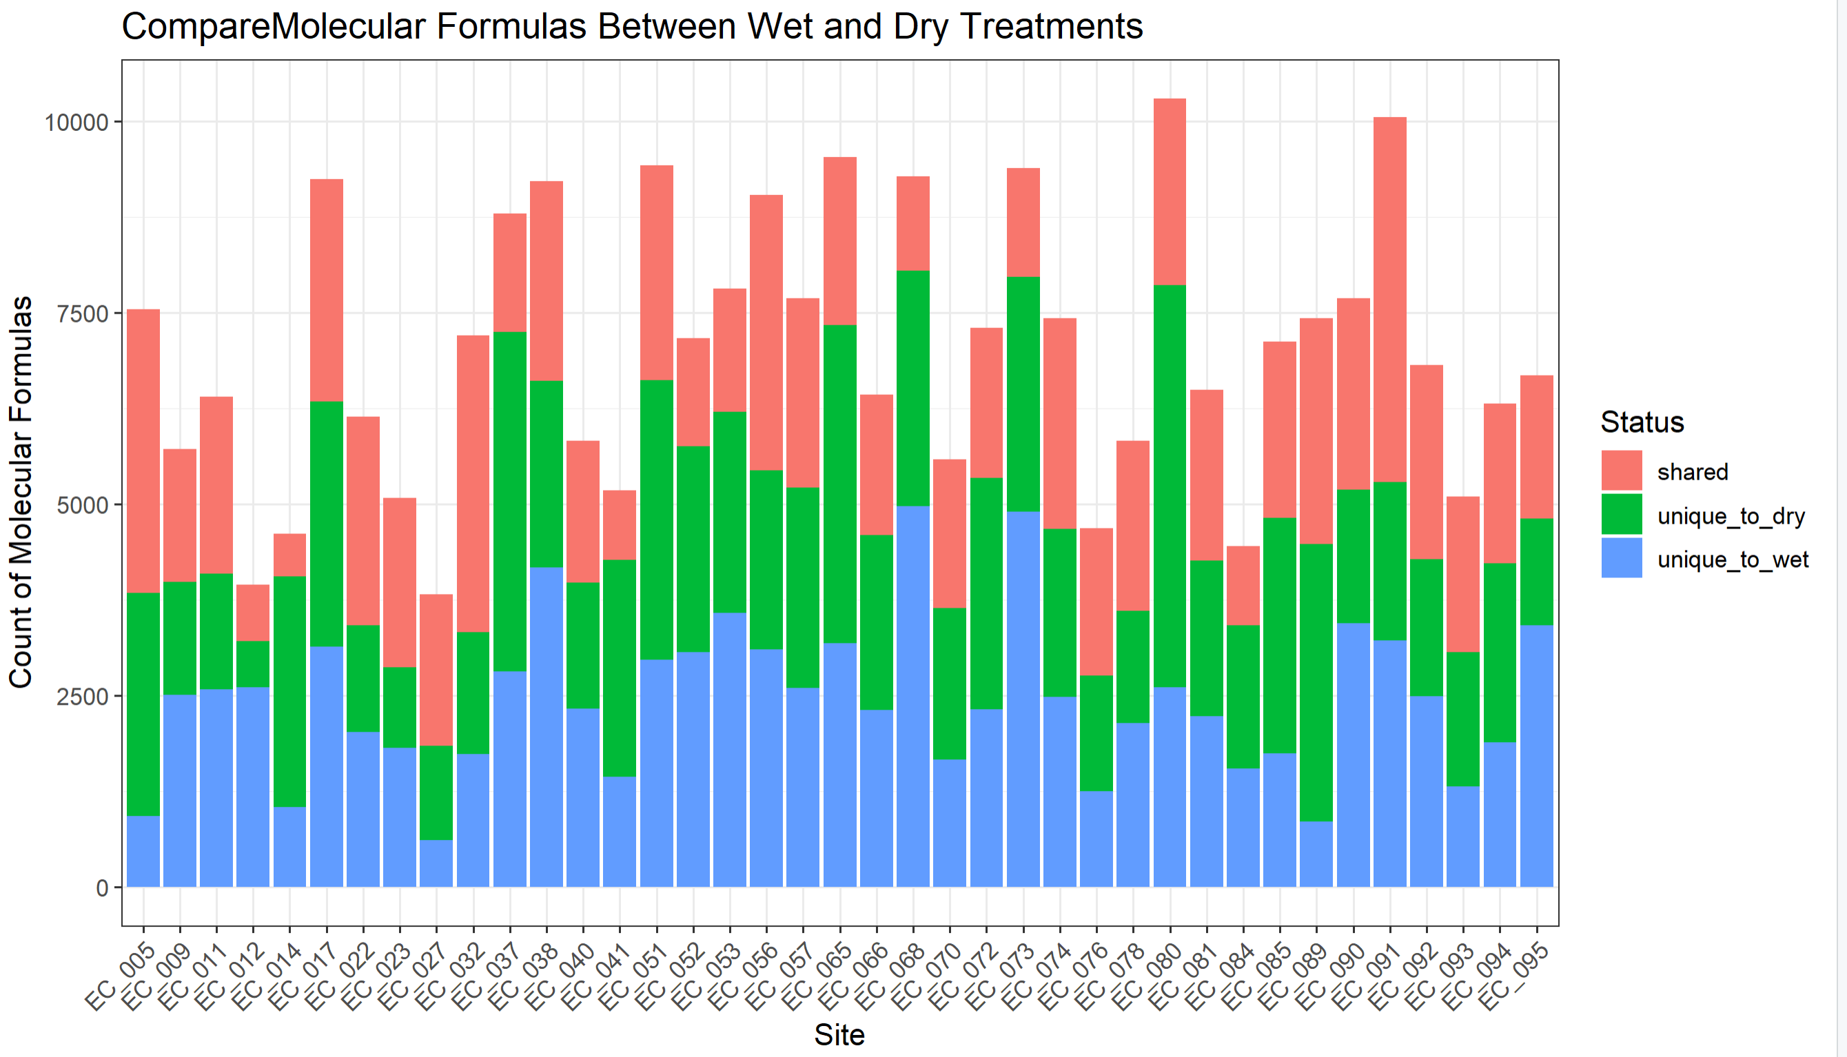

Slide 7
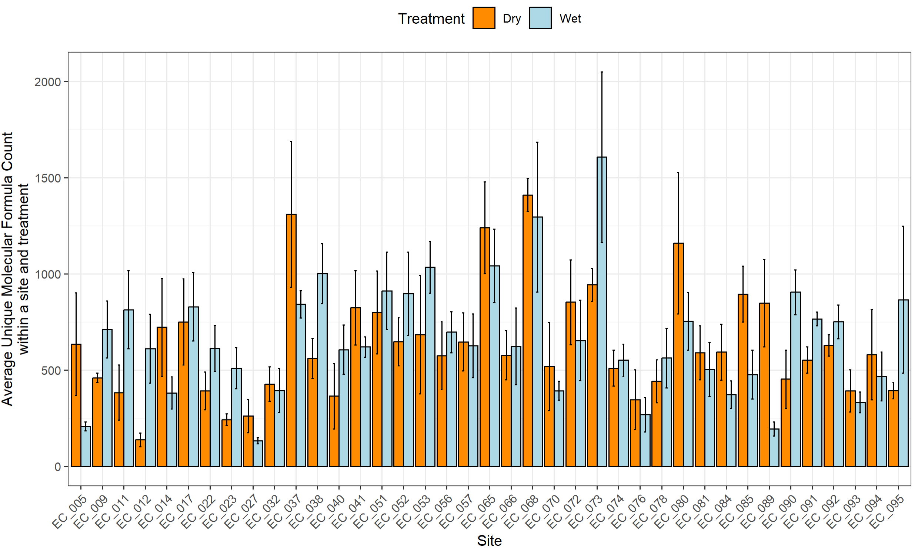
currently on Molecular_Formulas_per_site_per_treatment script

Slide 8
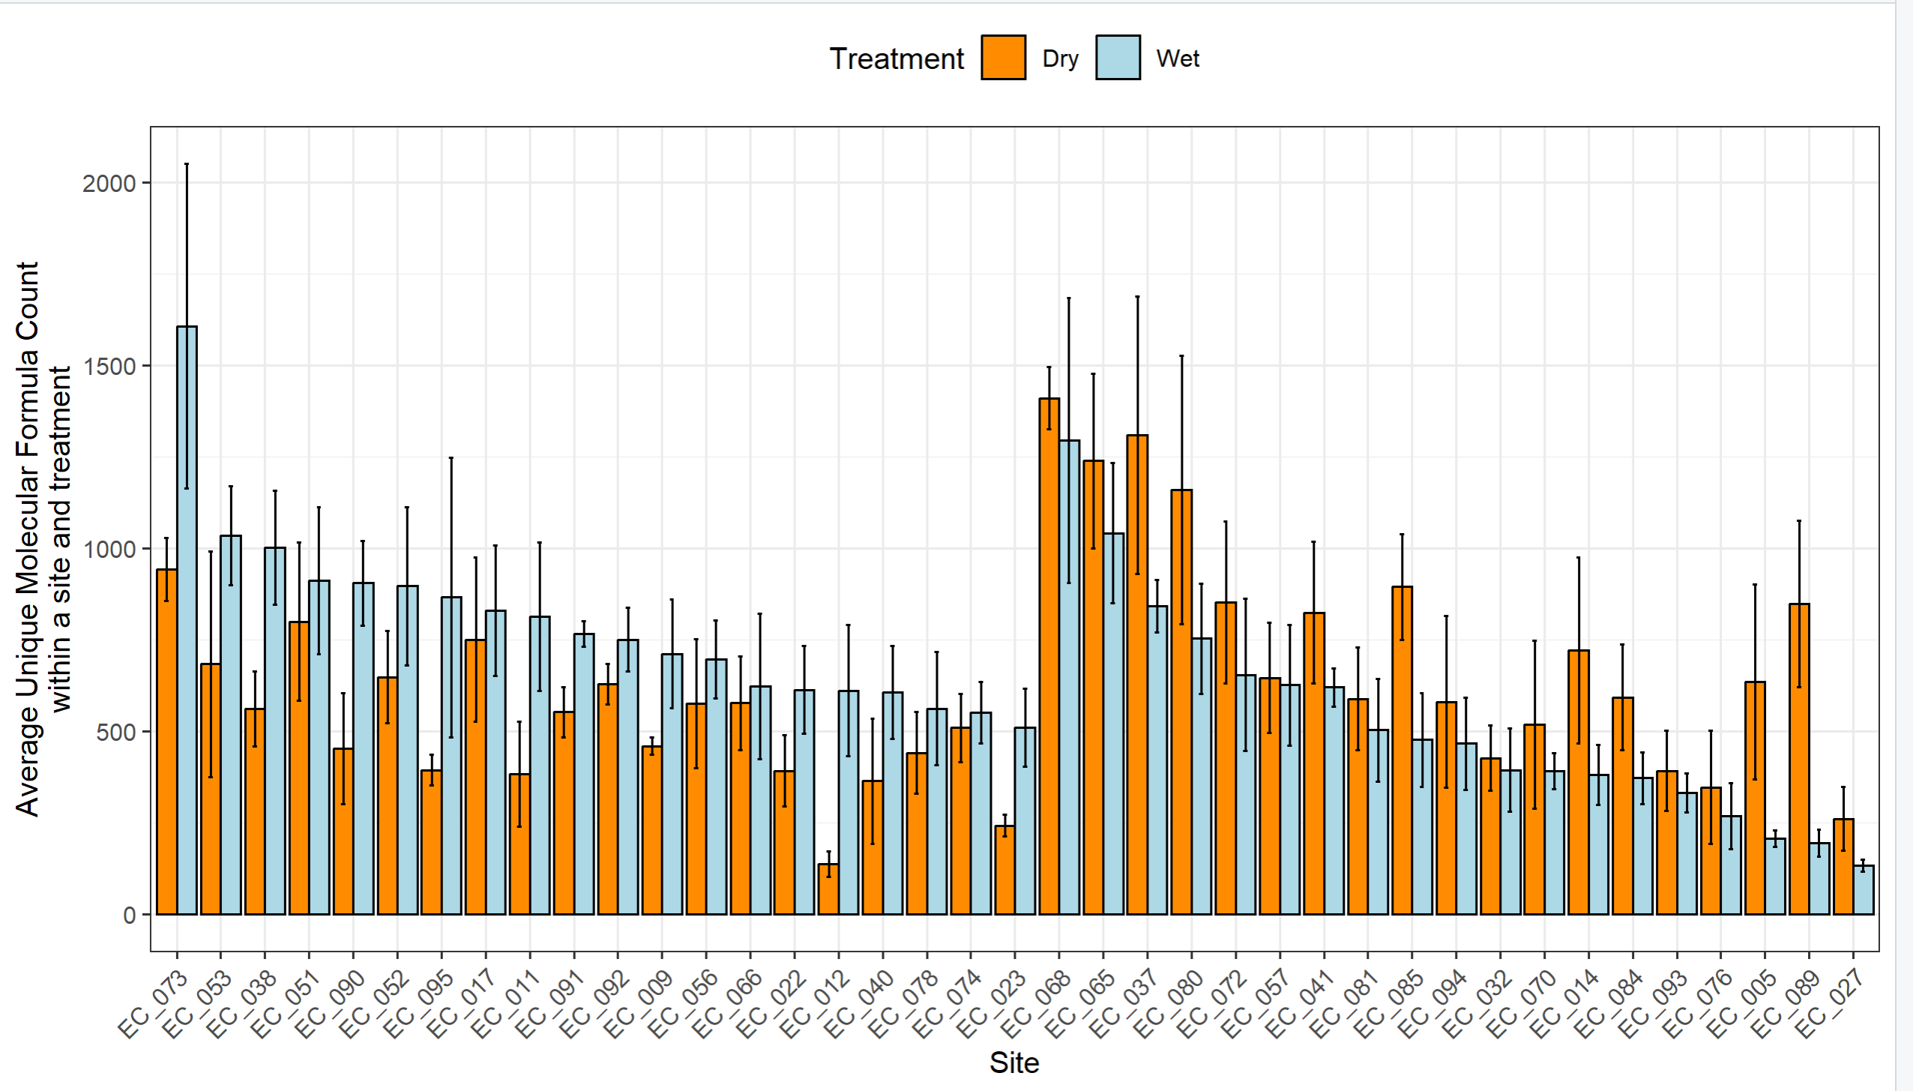
currently on Molecular_Formulas_per_site_per_treatment script
Higher unique avg formula count in wet treatment
Higher unique avg formula count in dry treatment

Slide 9
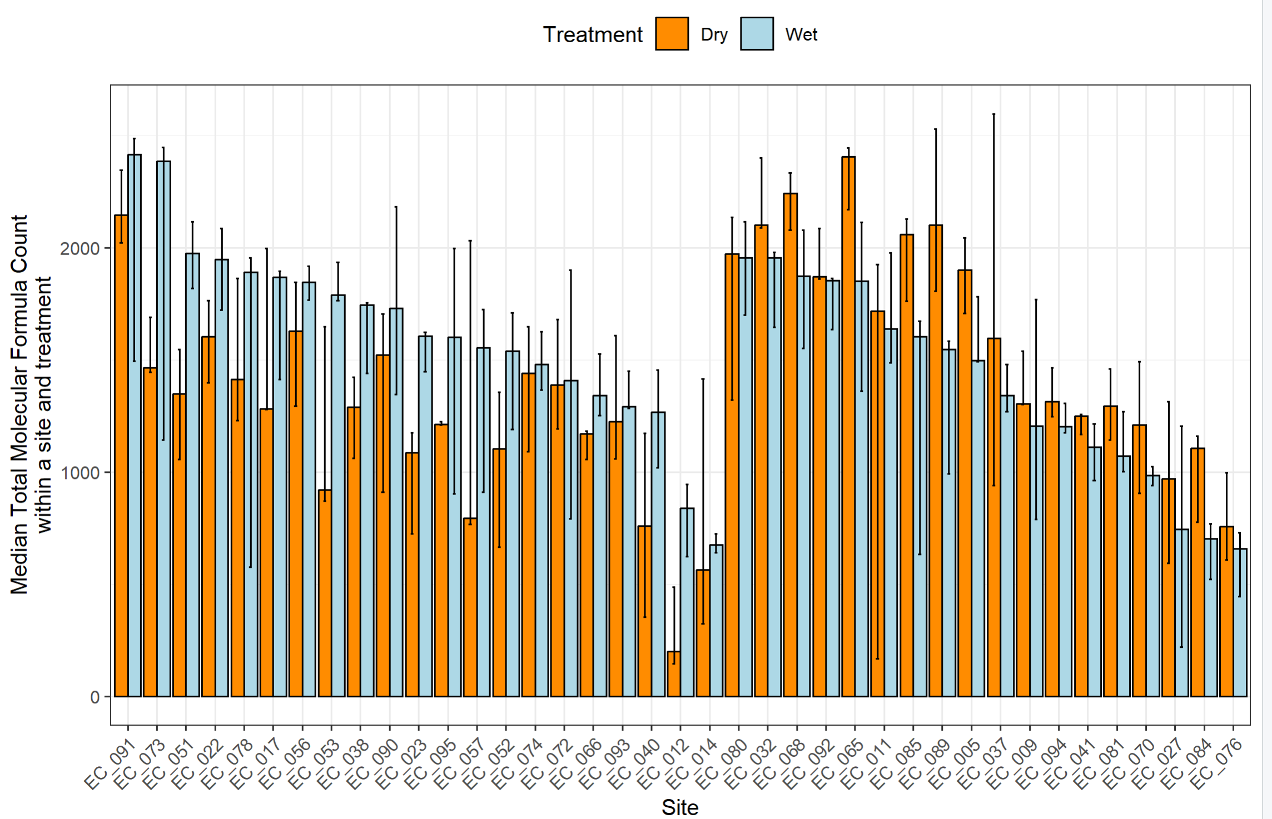
Currently on all_MF script

Slide 10
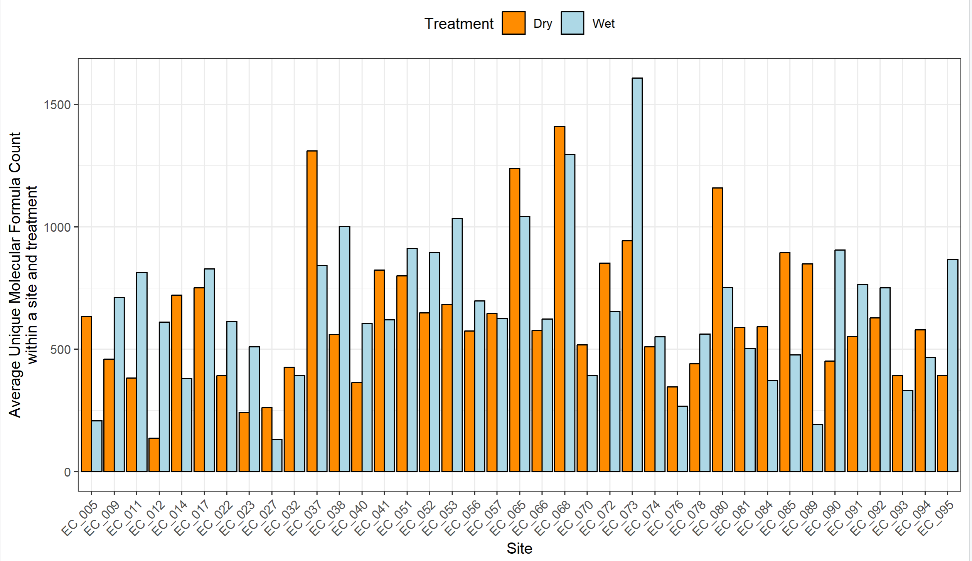
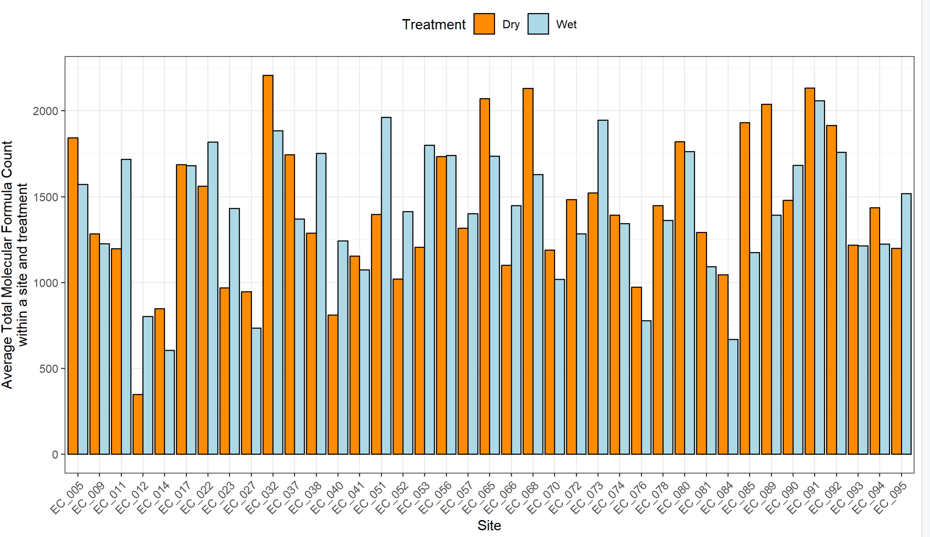
Separate the FTICR adata with only the unique formulars per wet and dry treatment and look at broad histograms and density plots of all sites but when we have only the unique formulas
Unique MF within Site/Treatment
Total MF count within Site/Treatment

Slide 11
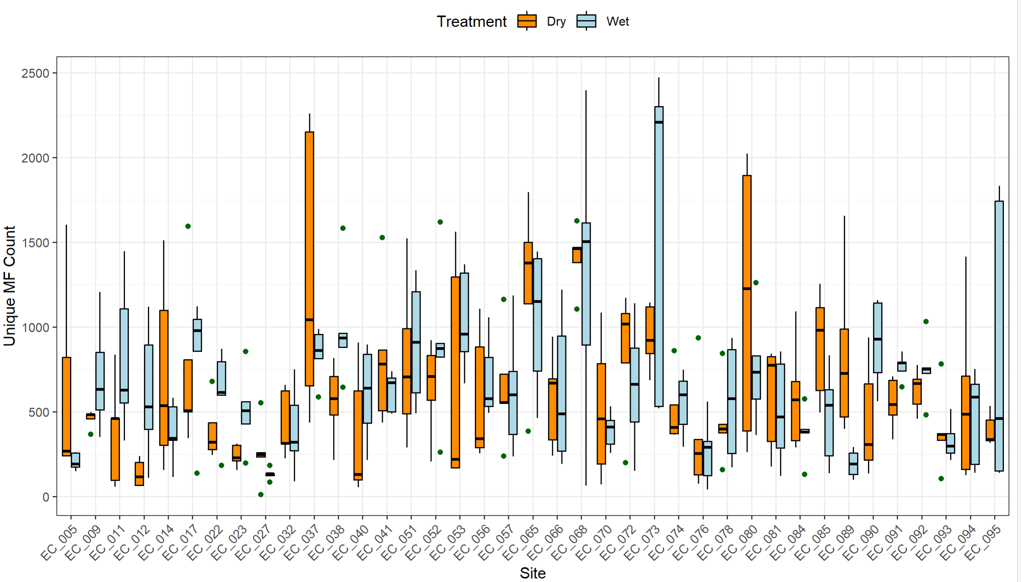
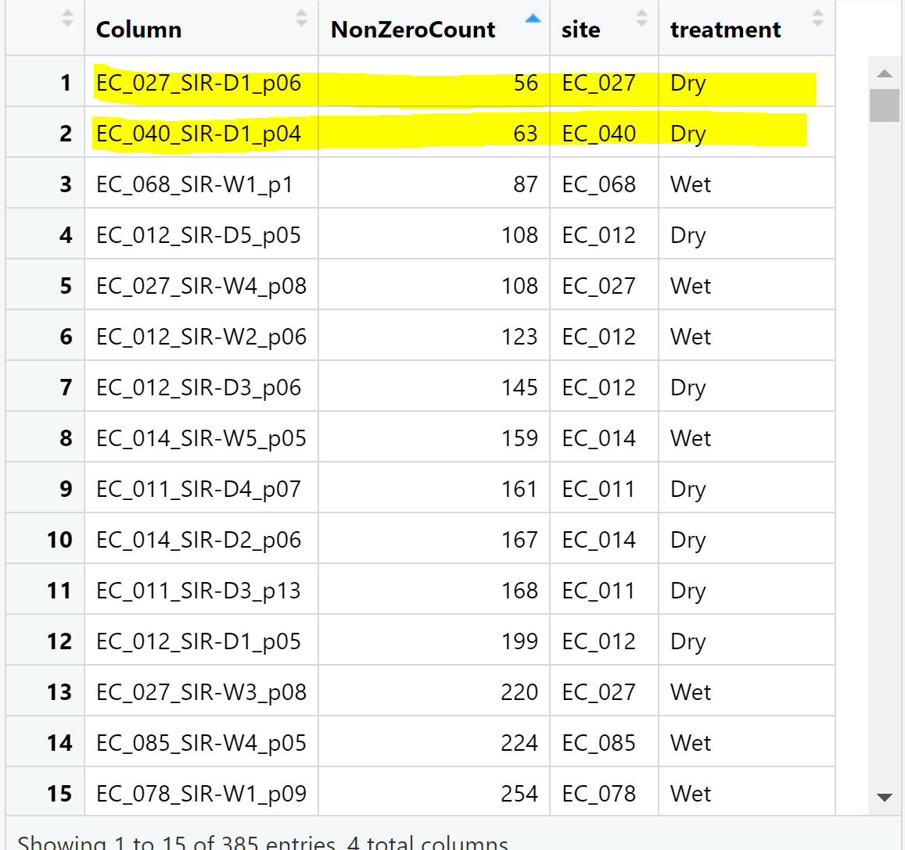
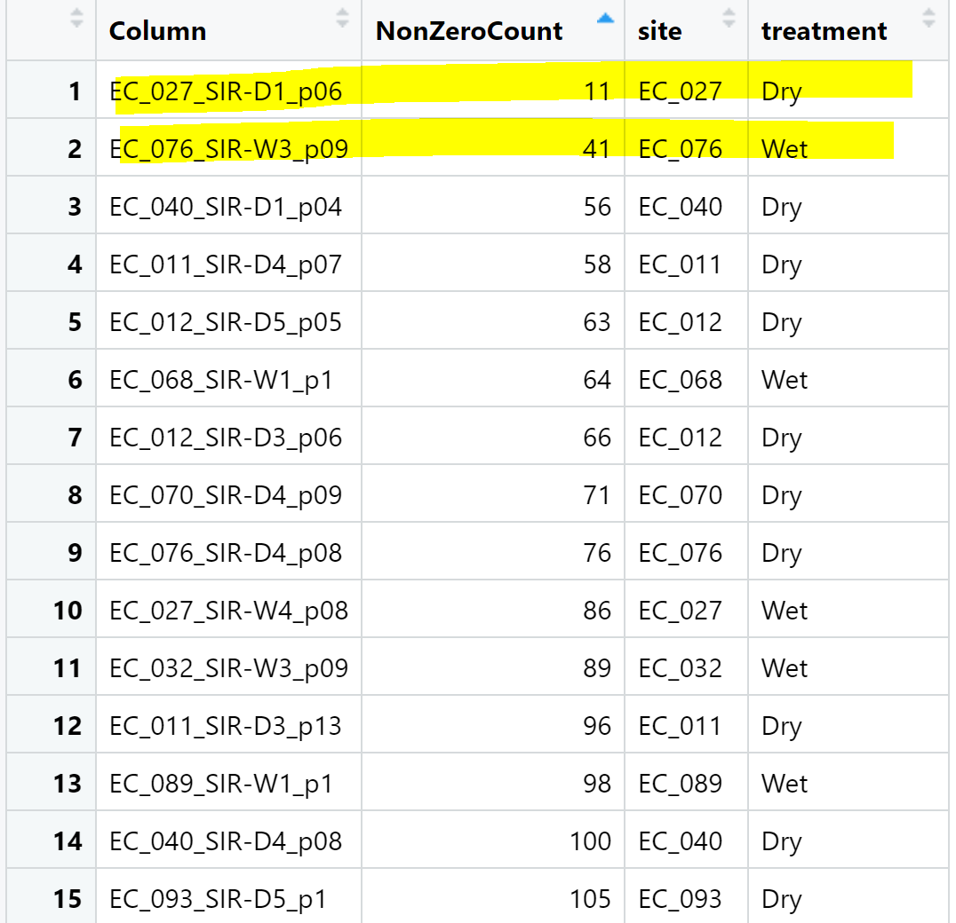
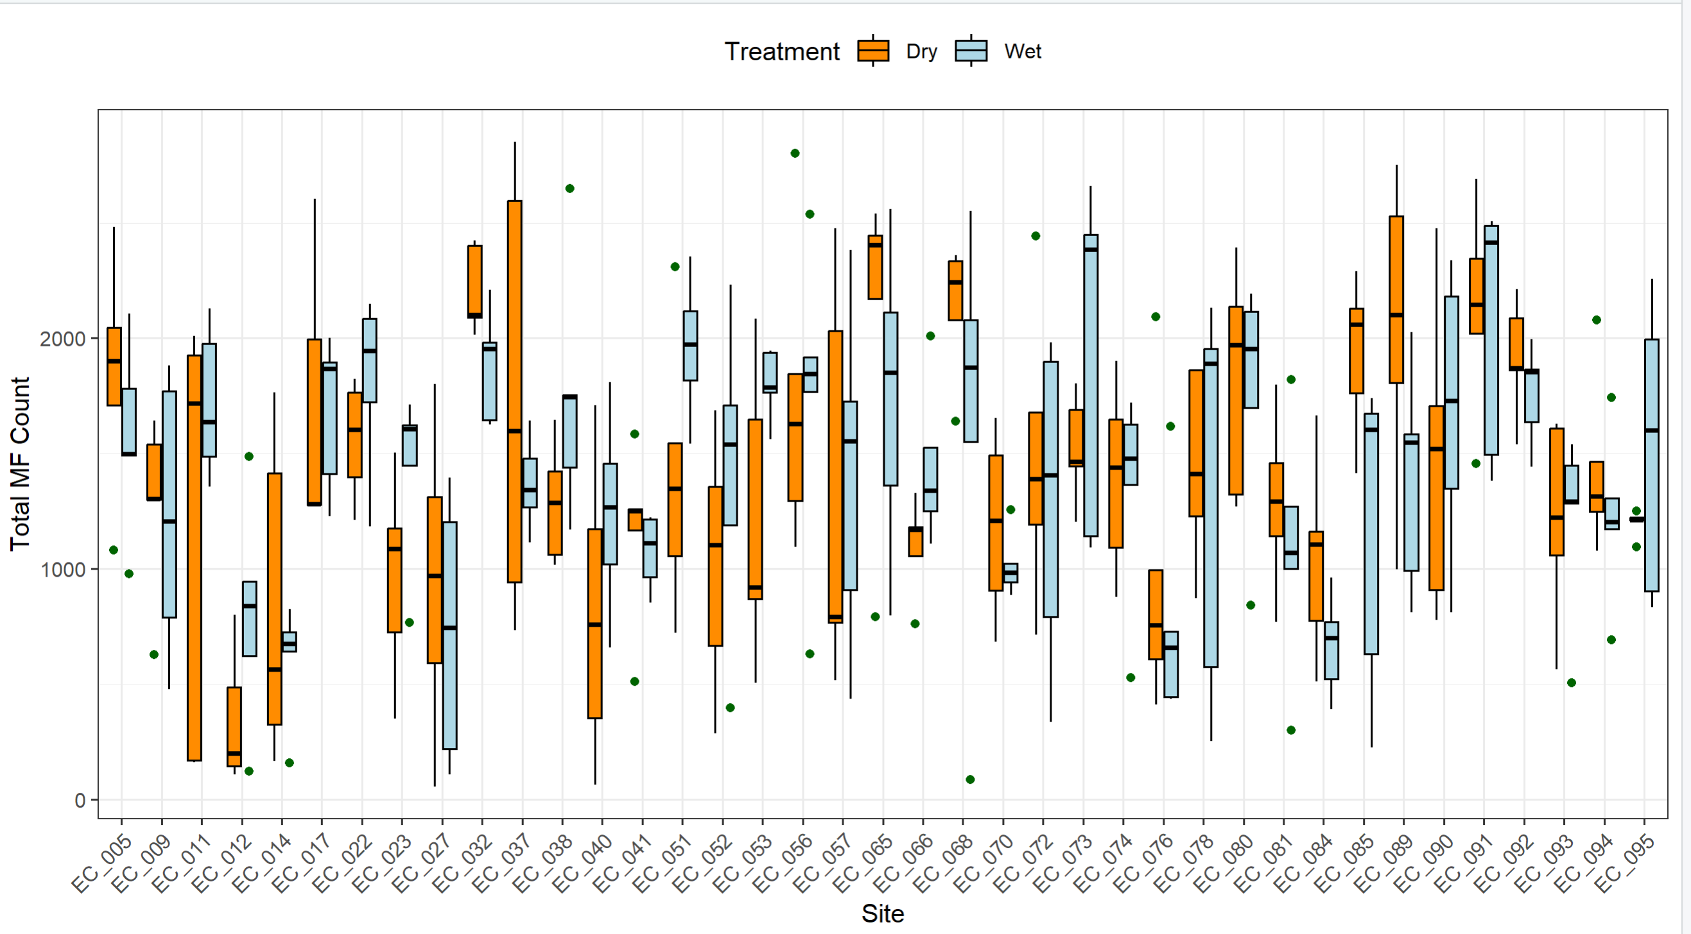
Total MF count within Site/Treatment
Unique MF within Site/Treatment

Slide 12
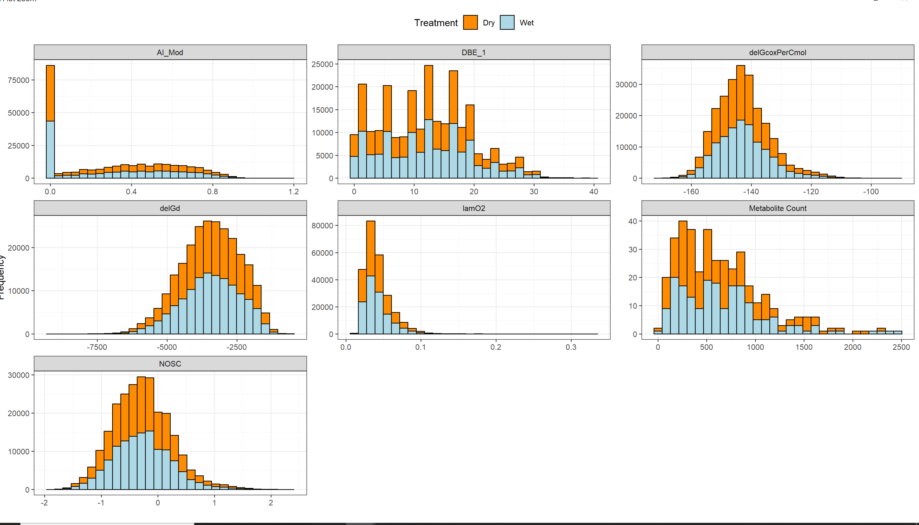
Unique peaks

Slide 13
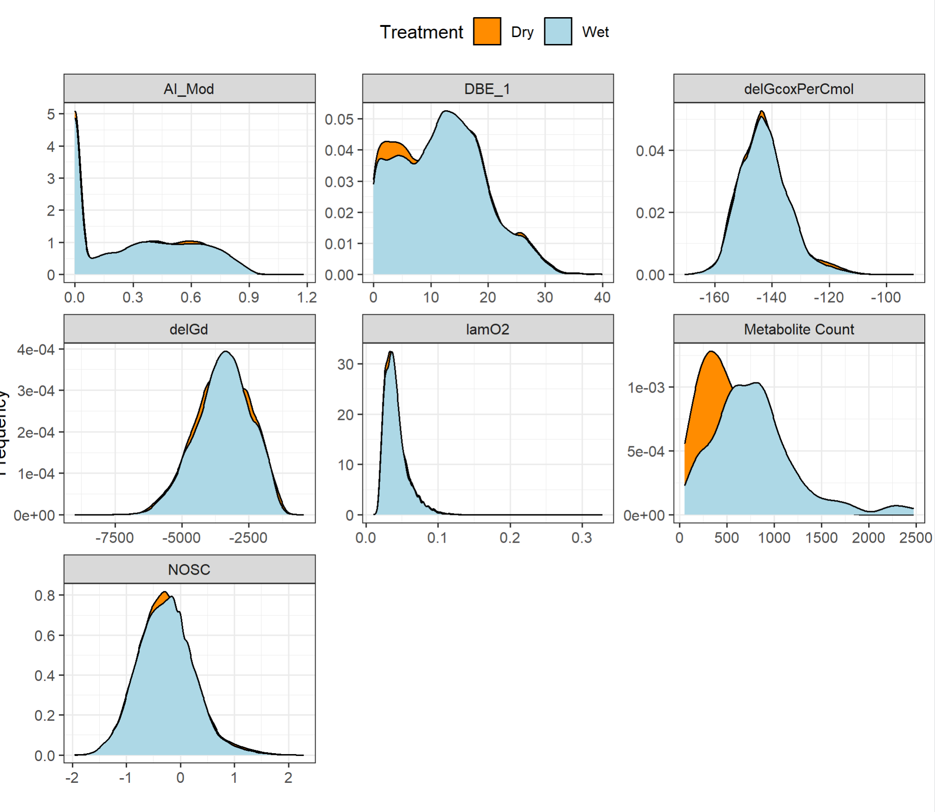
Group 1 higher metabolite count in wet treatment

Slide 14
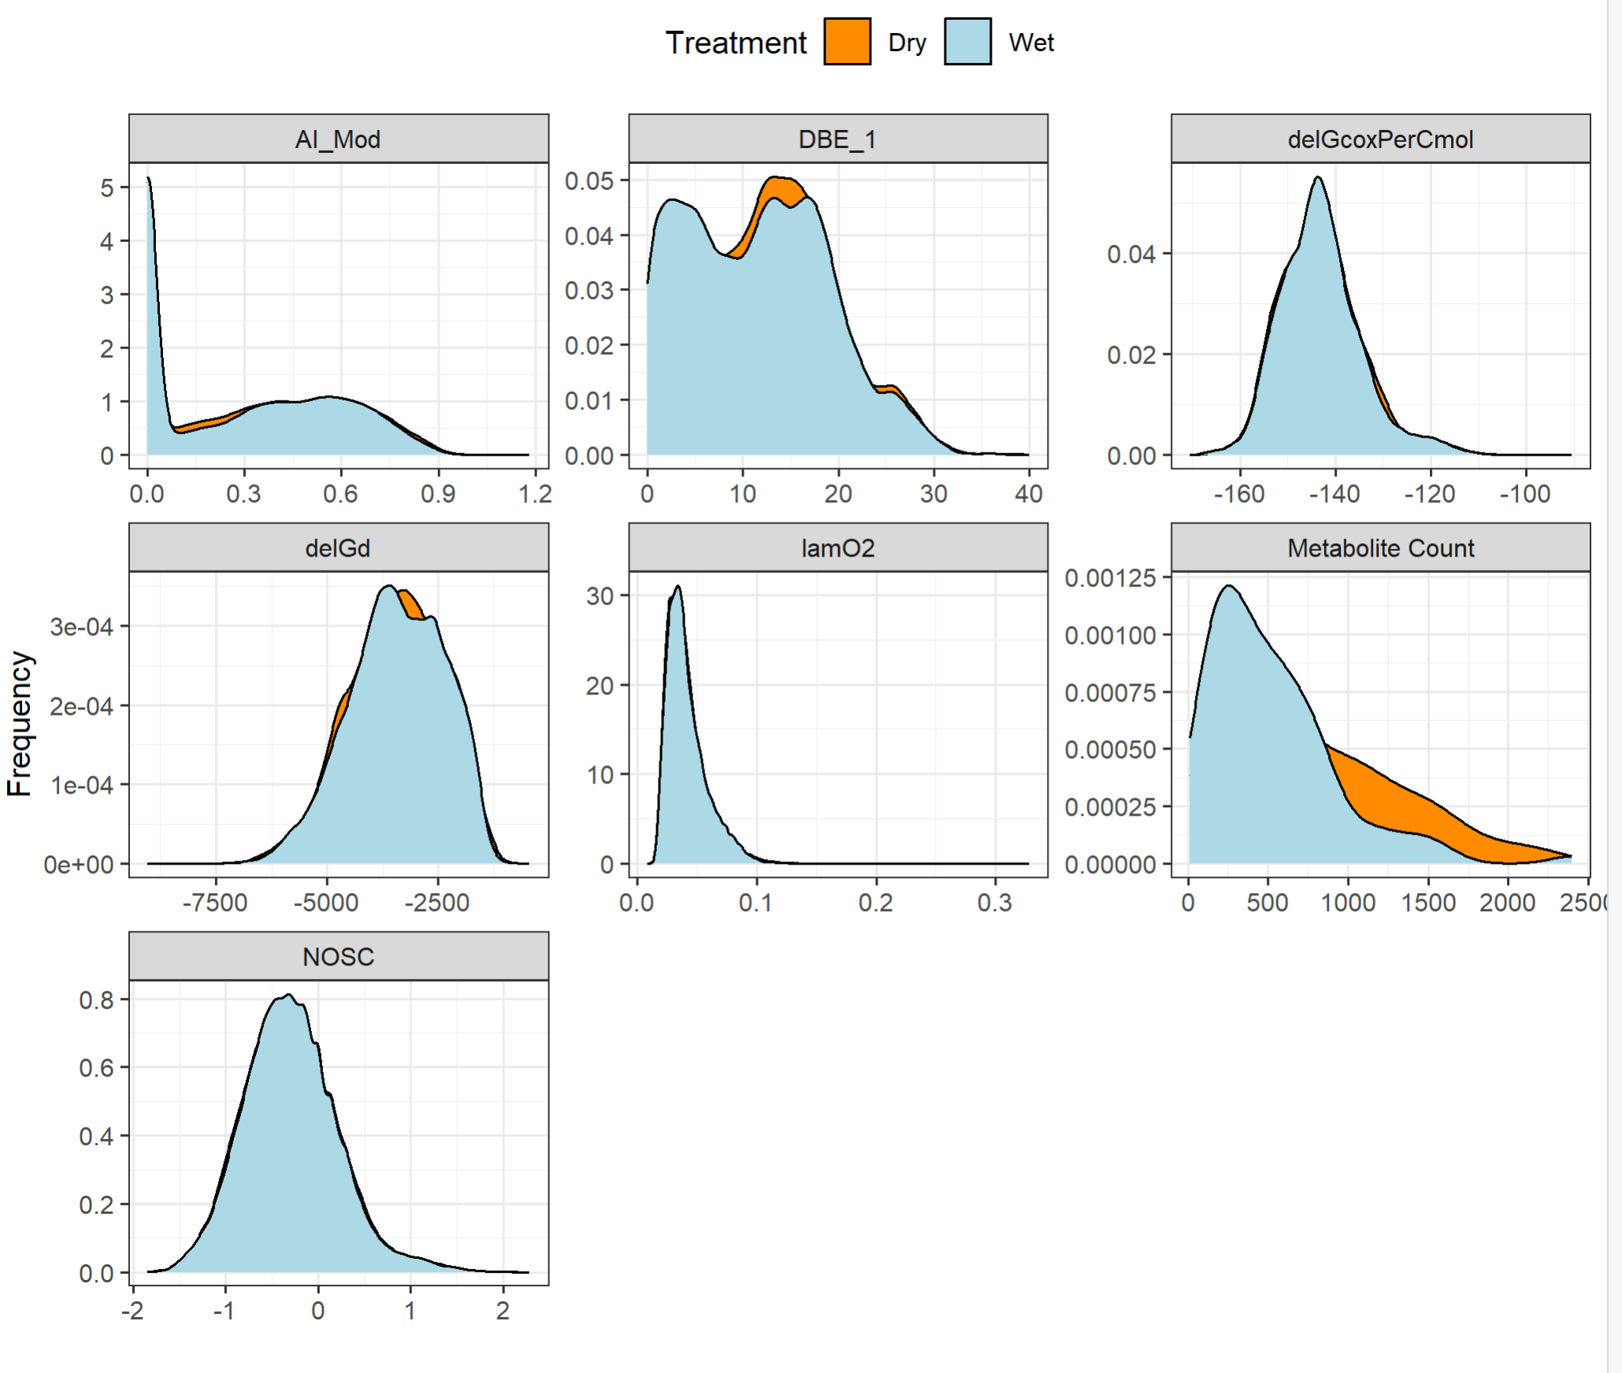
Group 2 higher avg metabolite count in dry

Slide 15
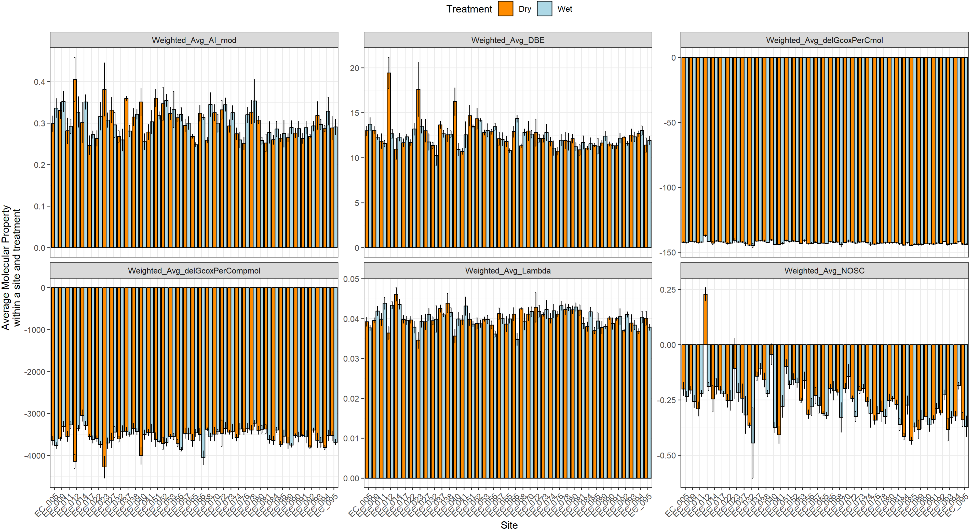

Slide 16
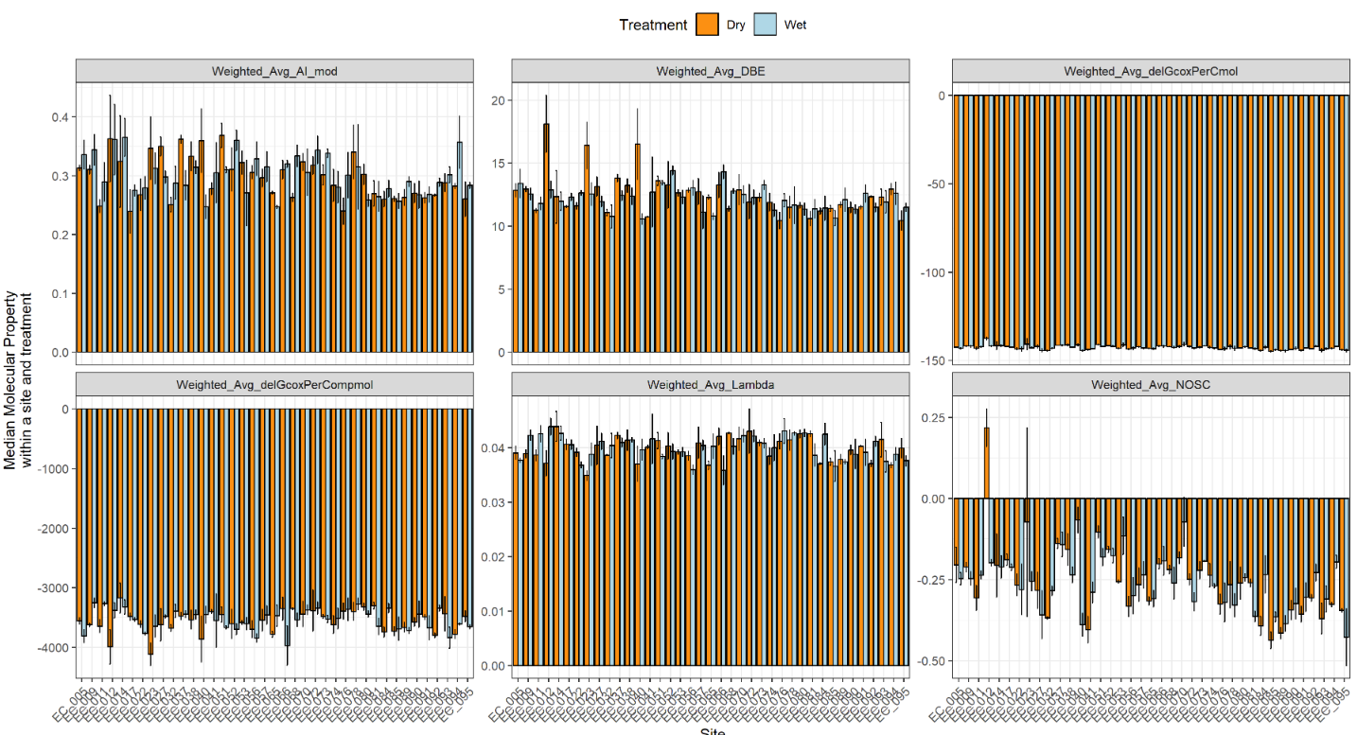

Slide 17
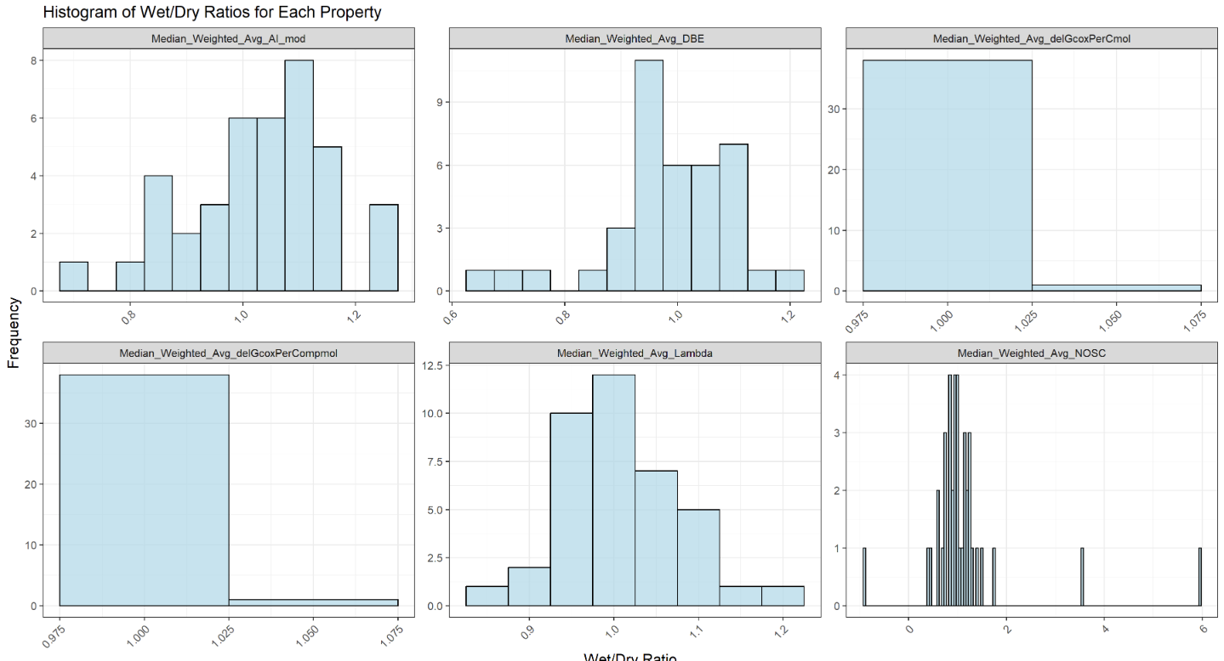

Slide 18
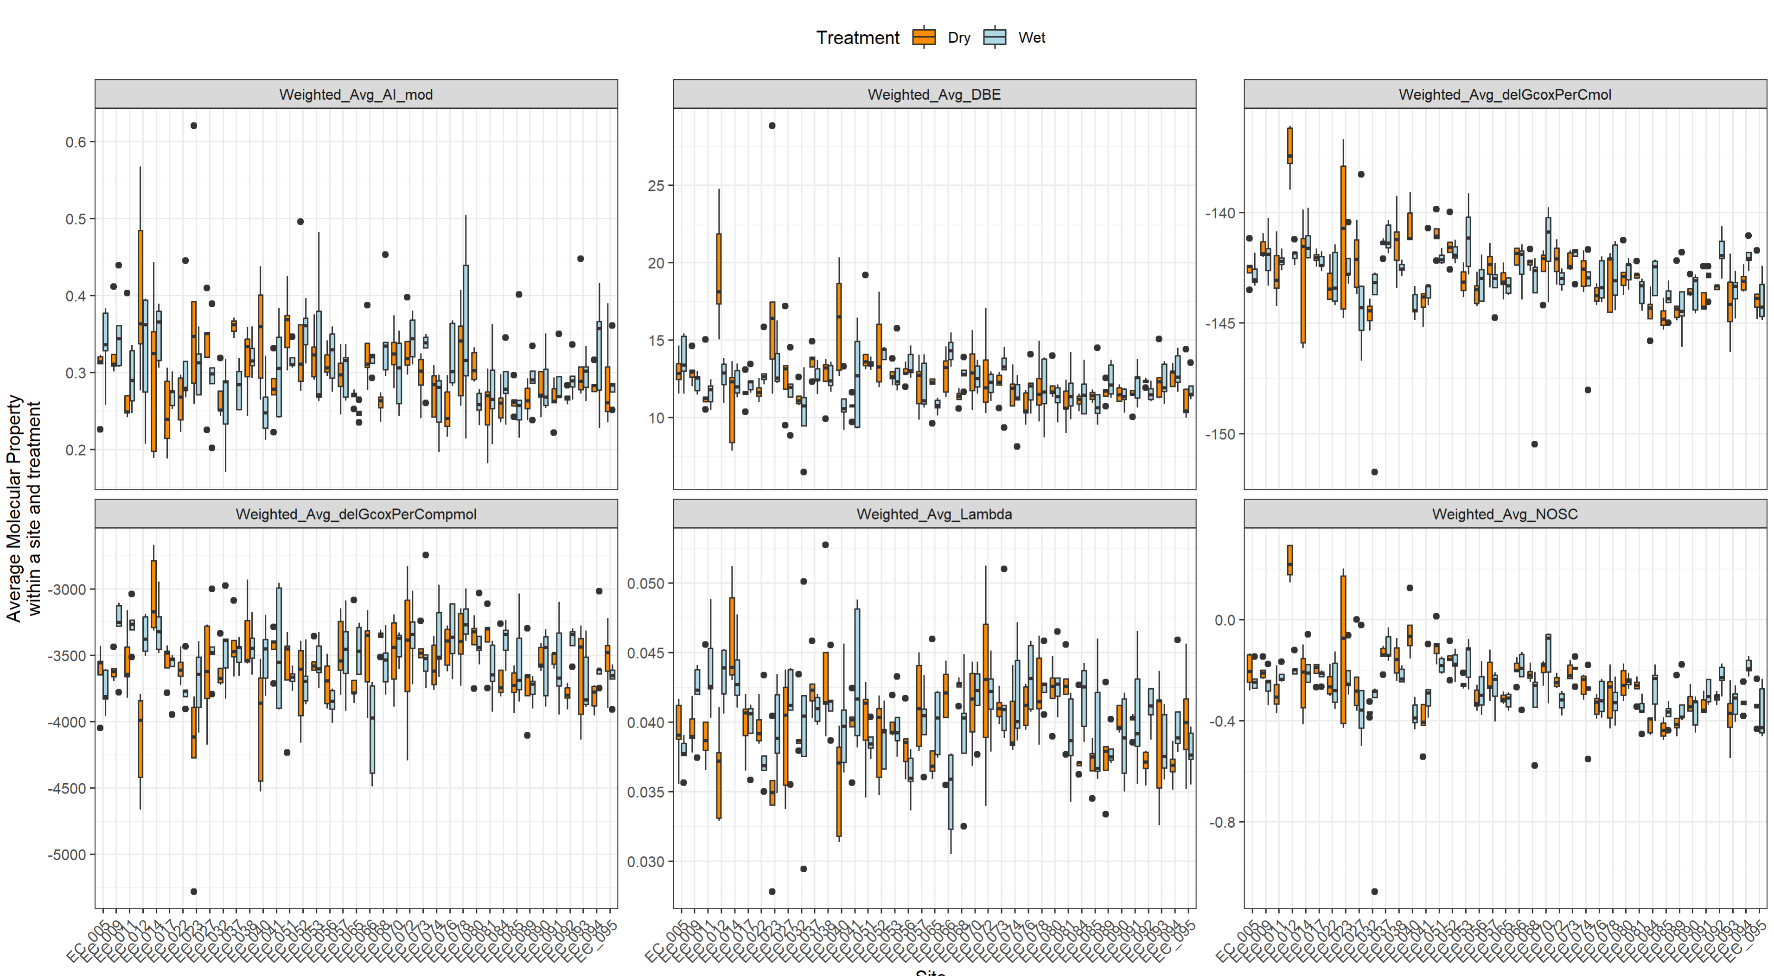

Slide 19
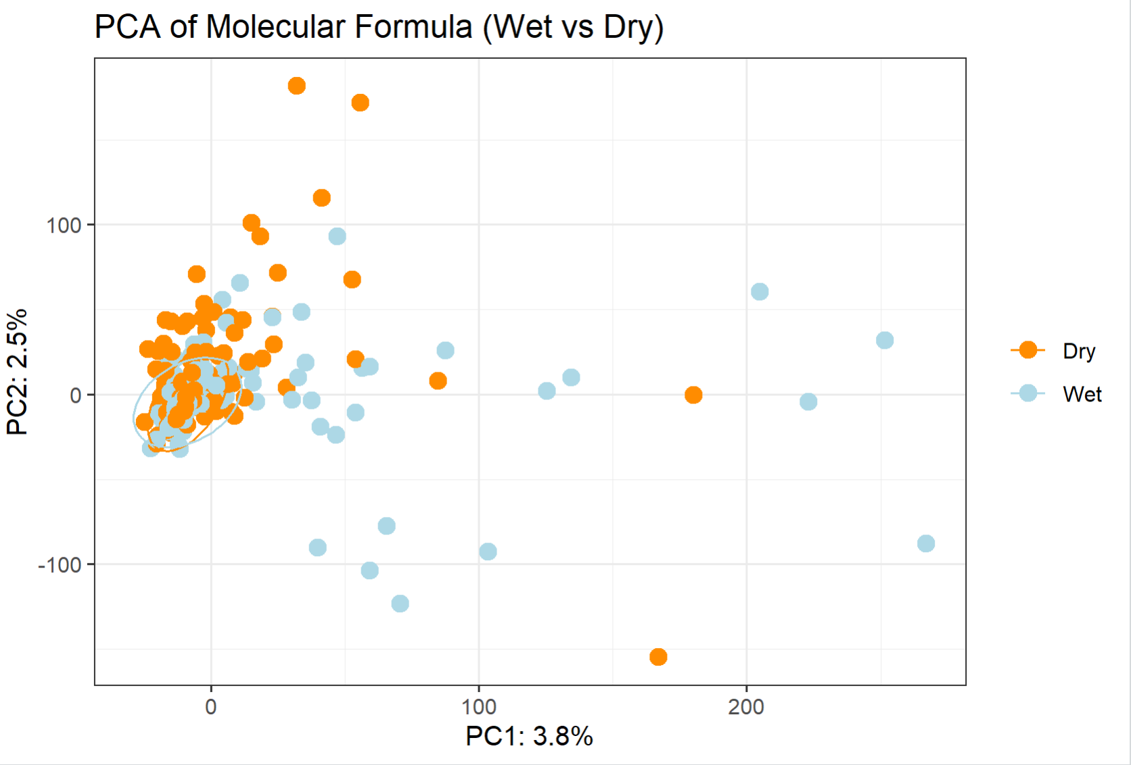

Slide 20
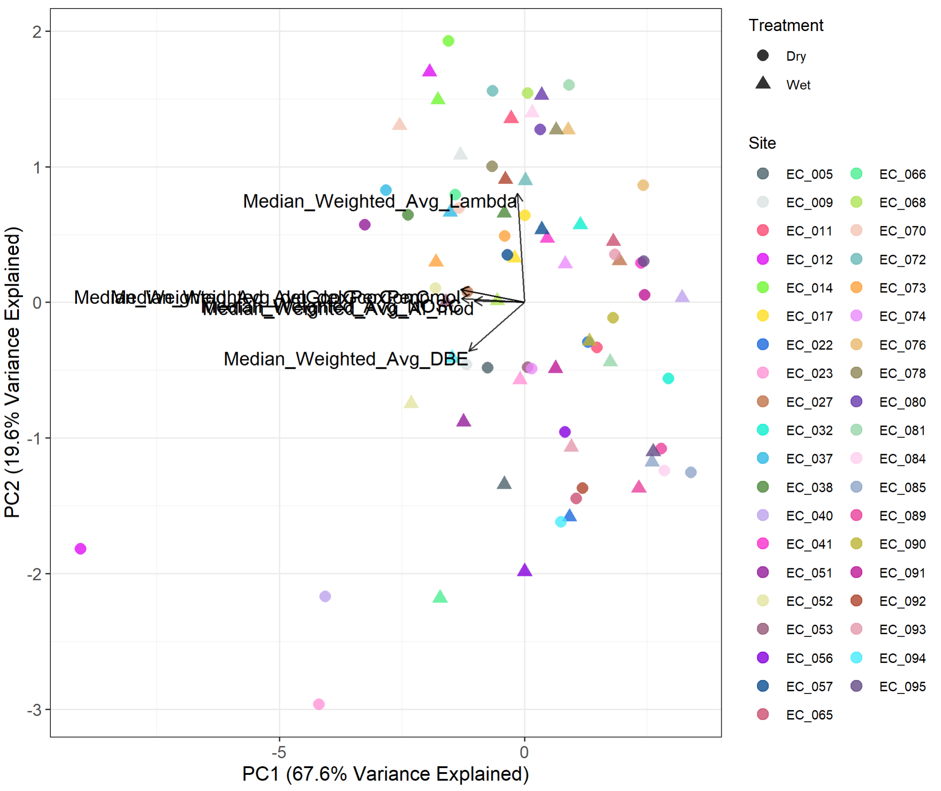

Slide 21
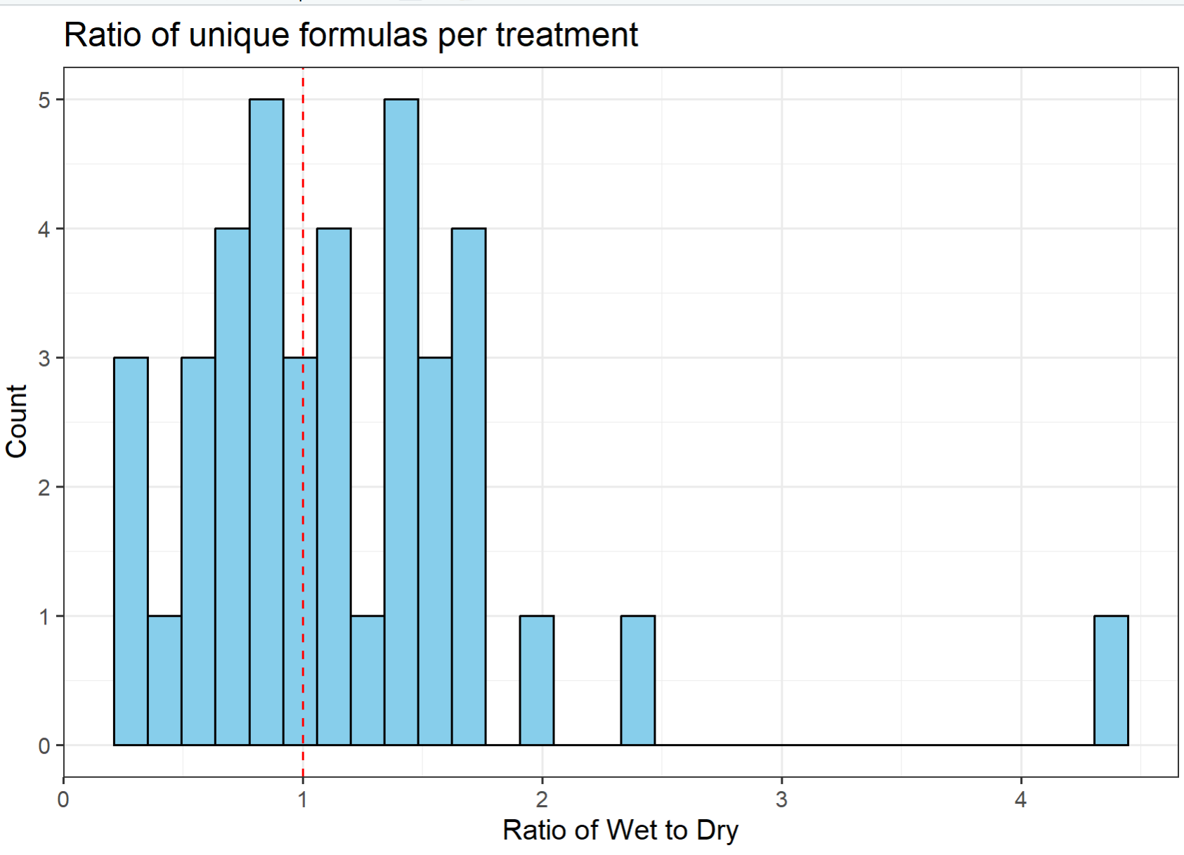
There are 18 sites with values lower than 1 and 21 sites with values higher than 1. Values higher than 1 mean that there are more unique formulas in the wet than in the dry treatment. Lower than 1 means the opposite

Slide 22
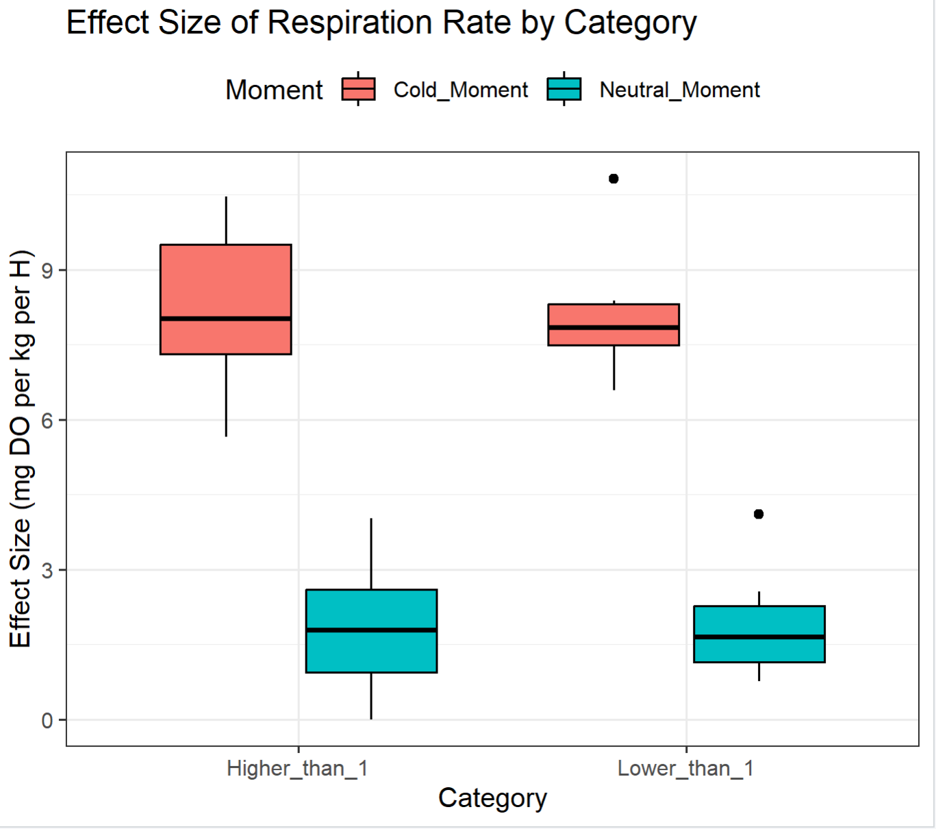
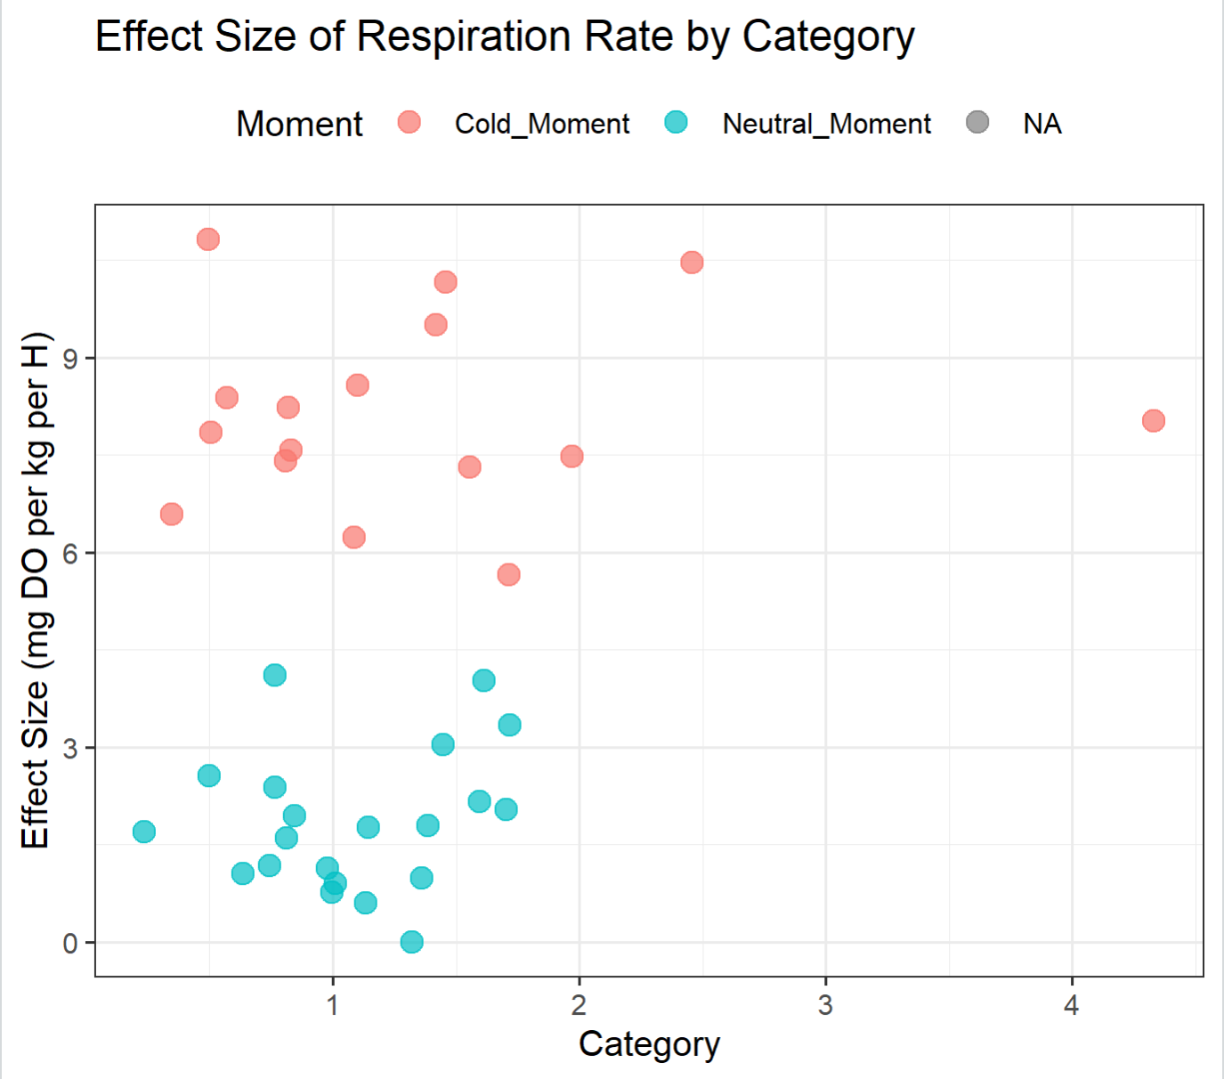

Slide 23
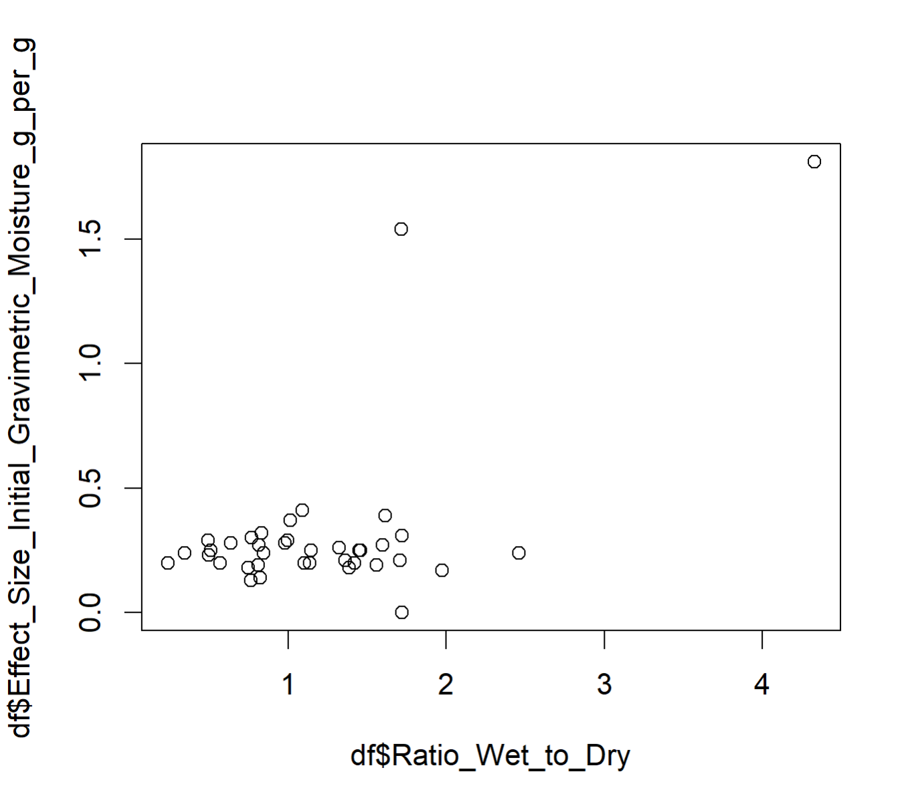
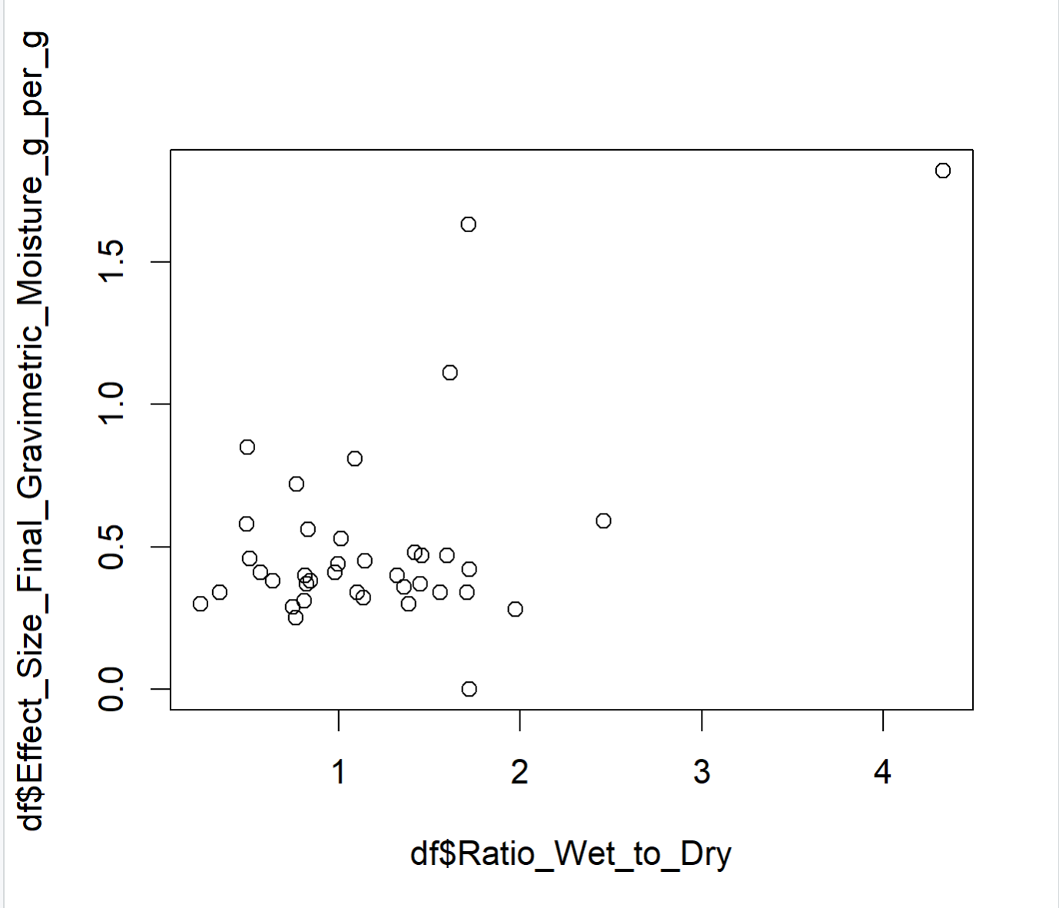

Slide 24
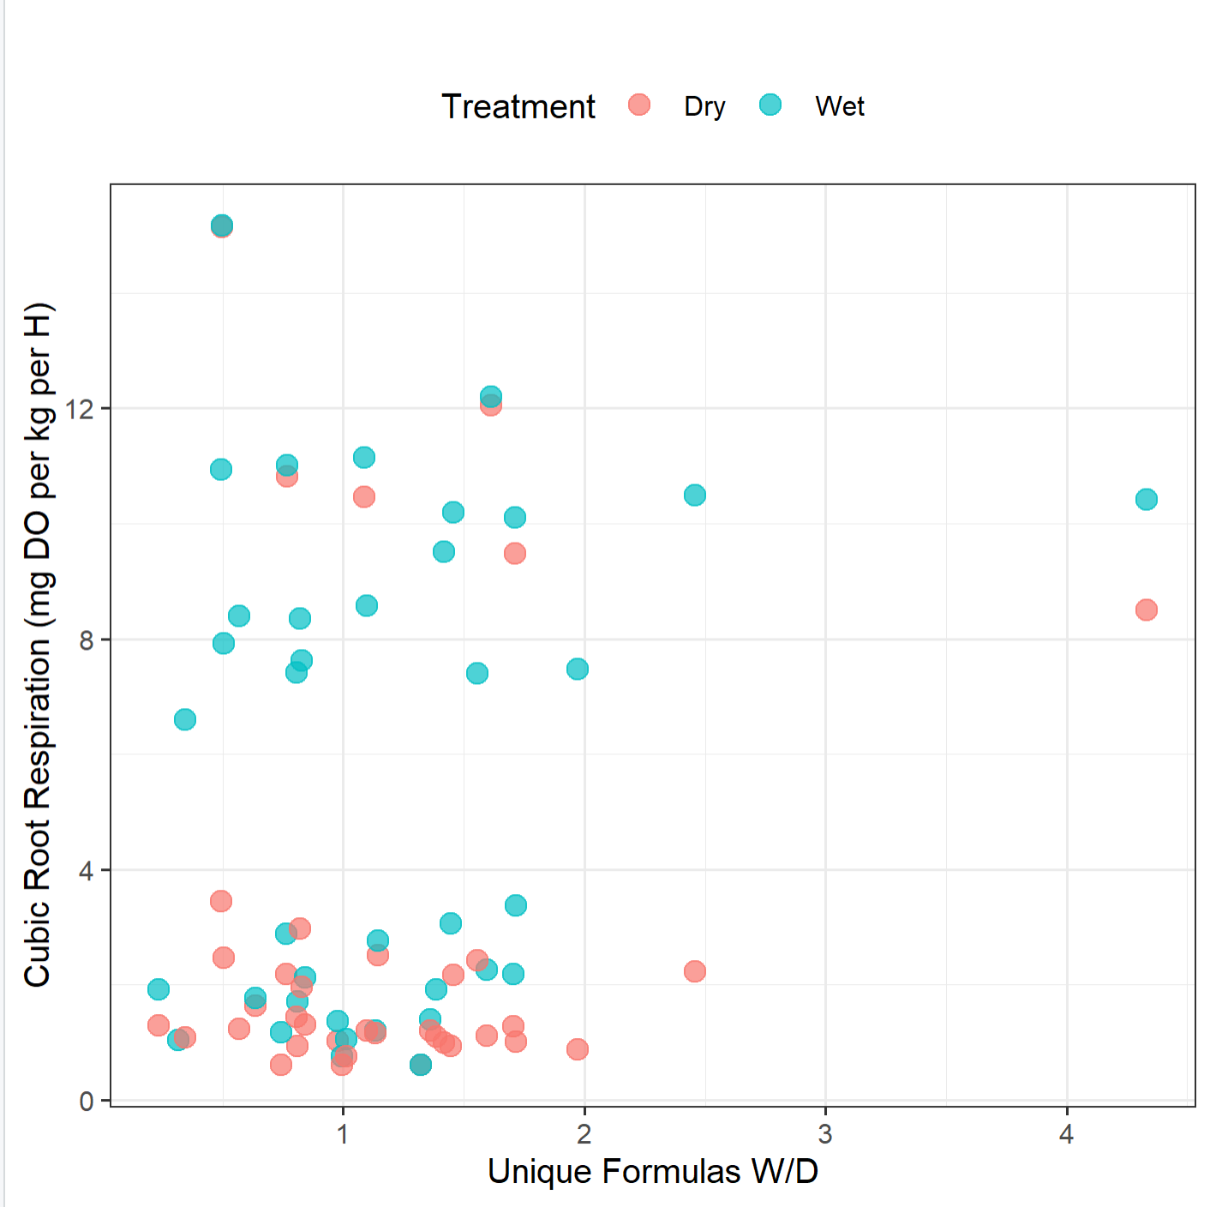
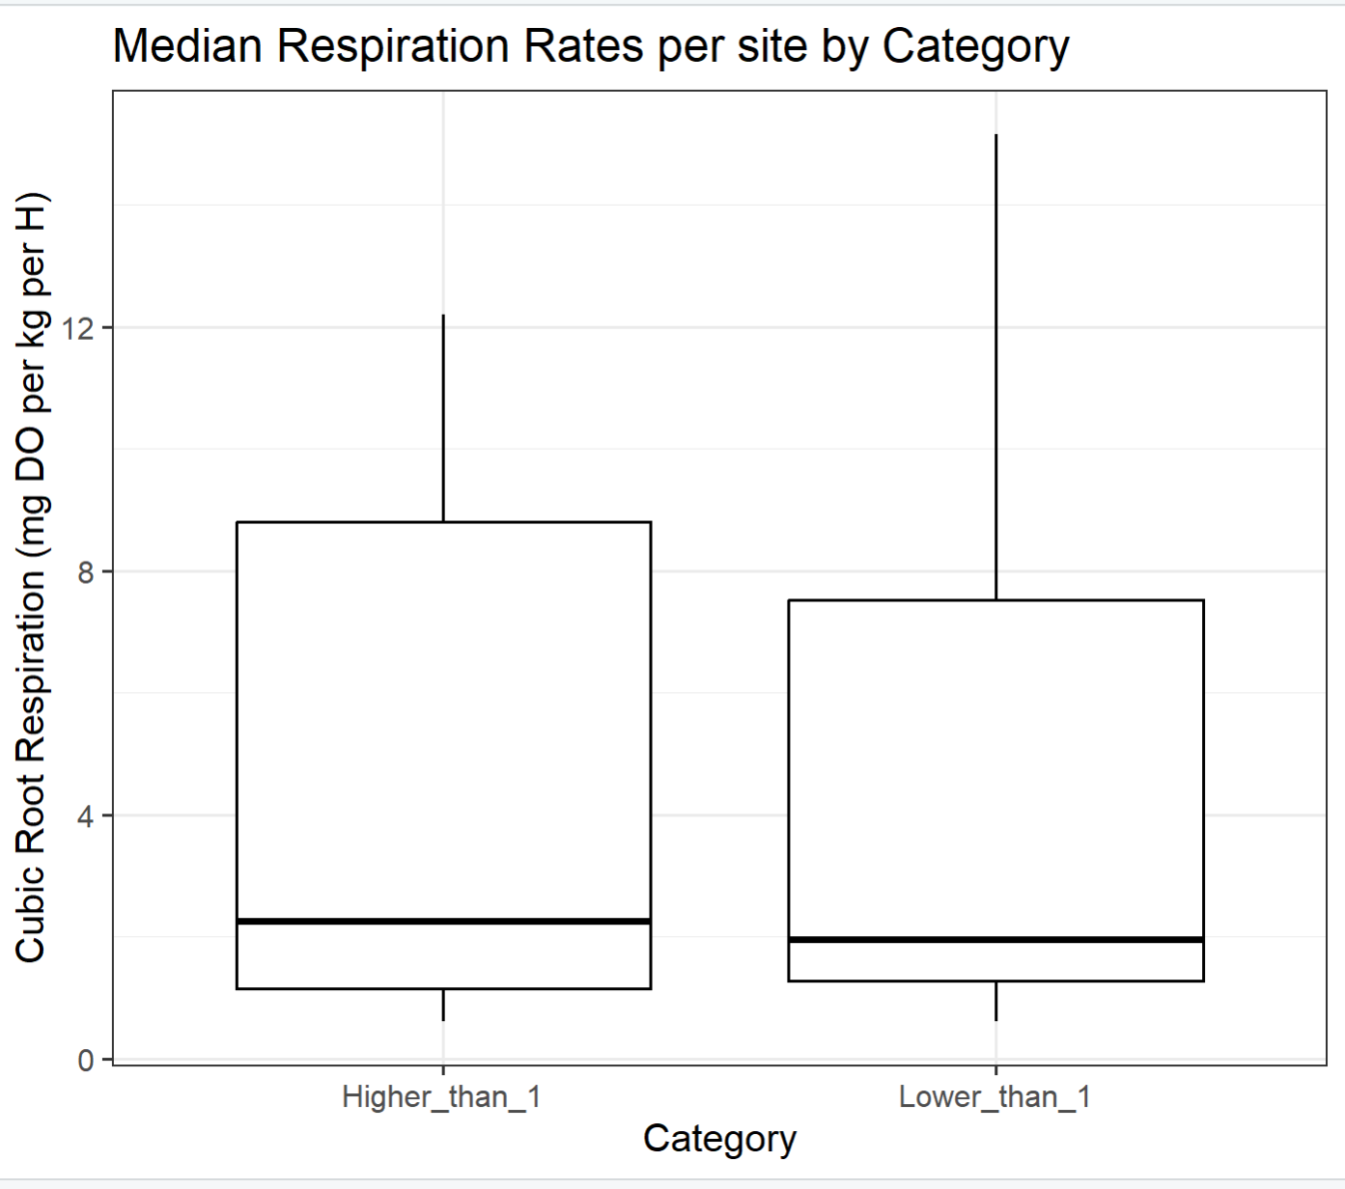

Slide 25
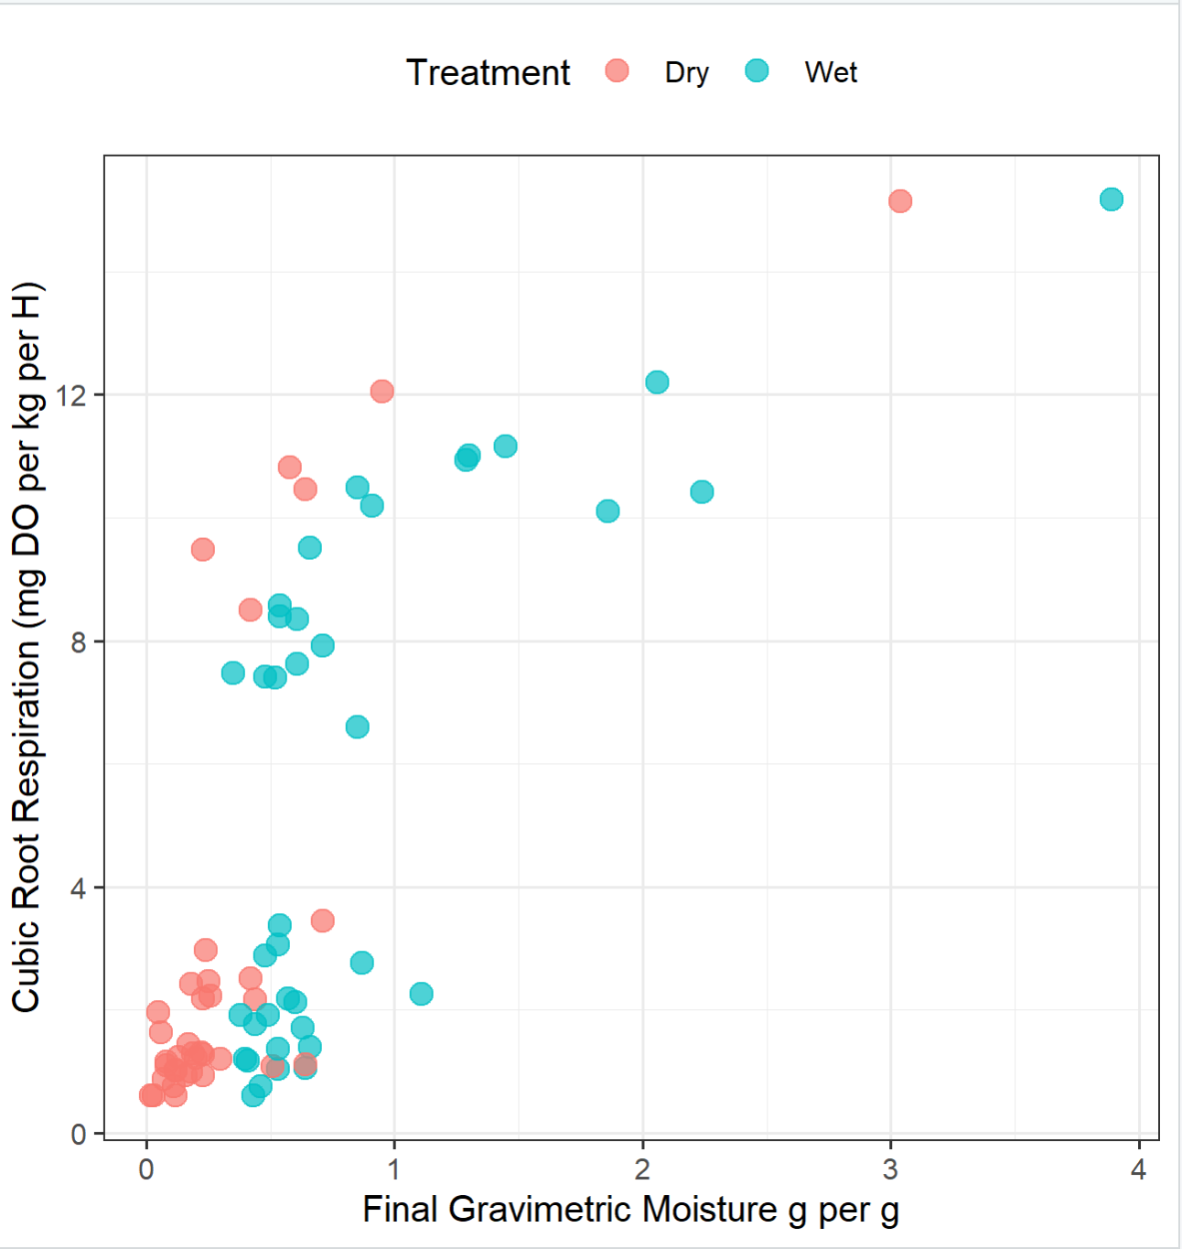
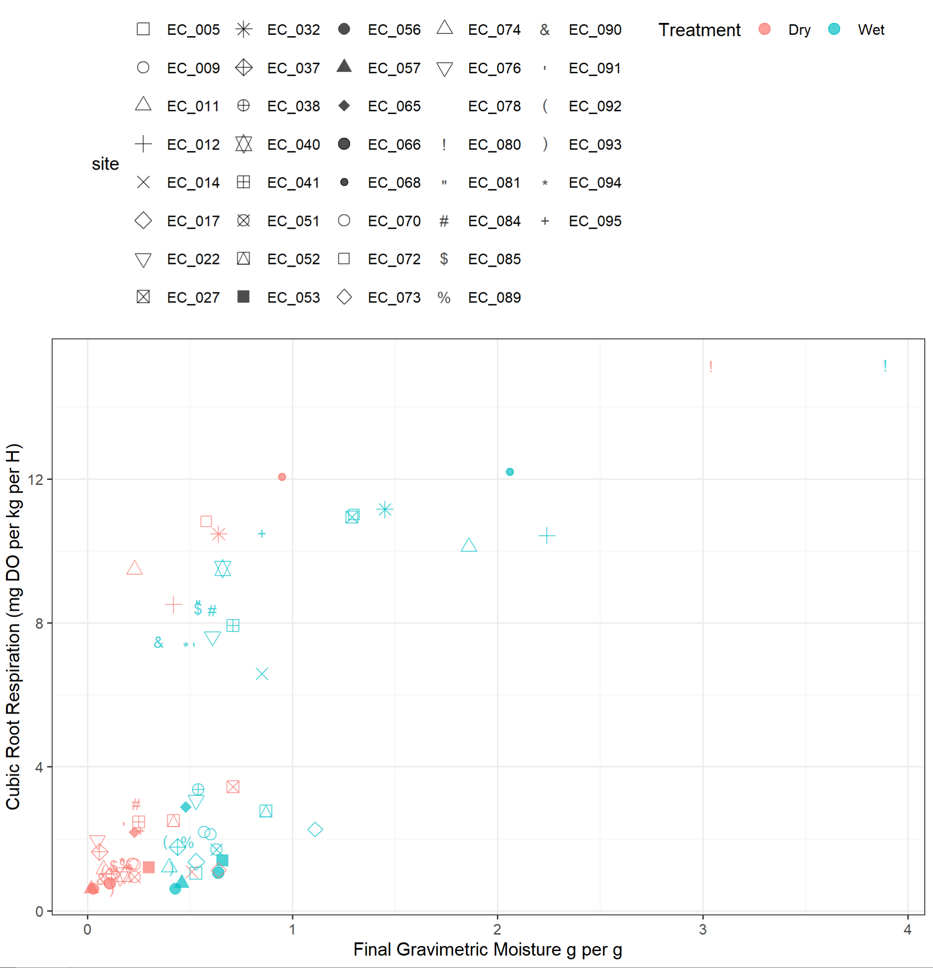
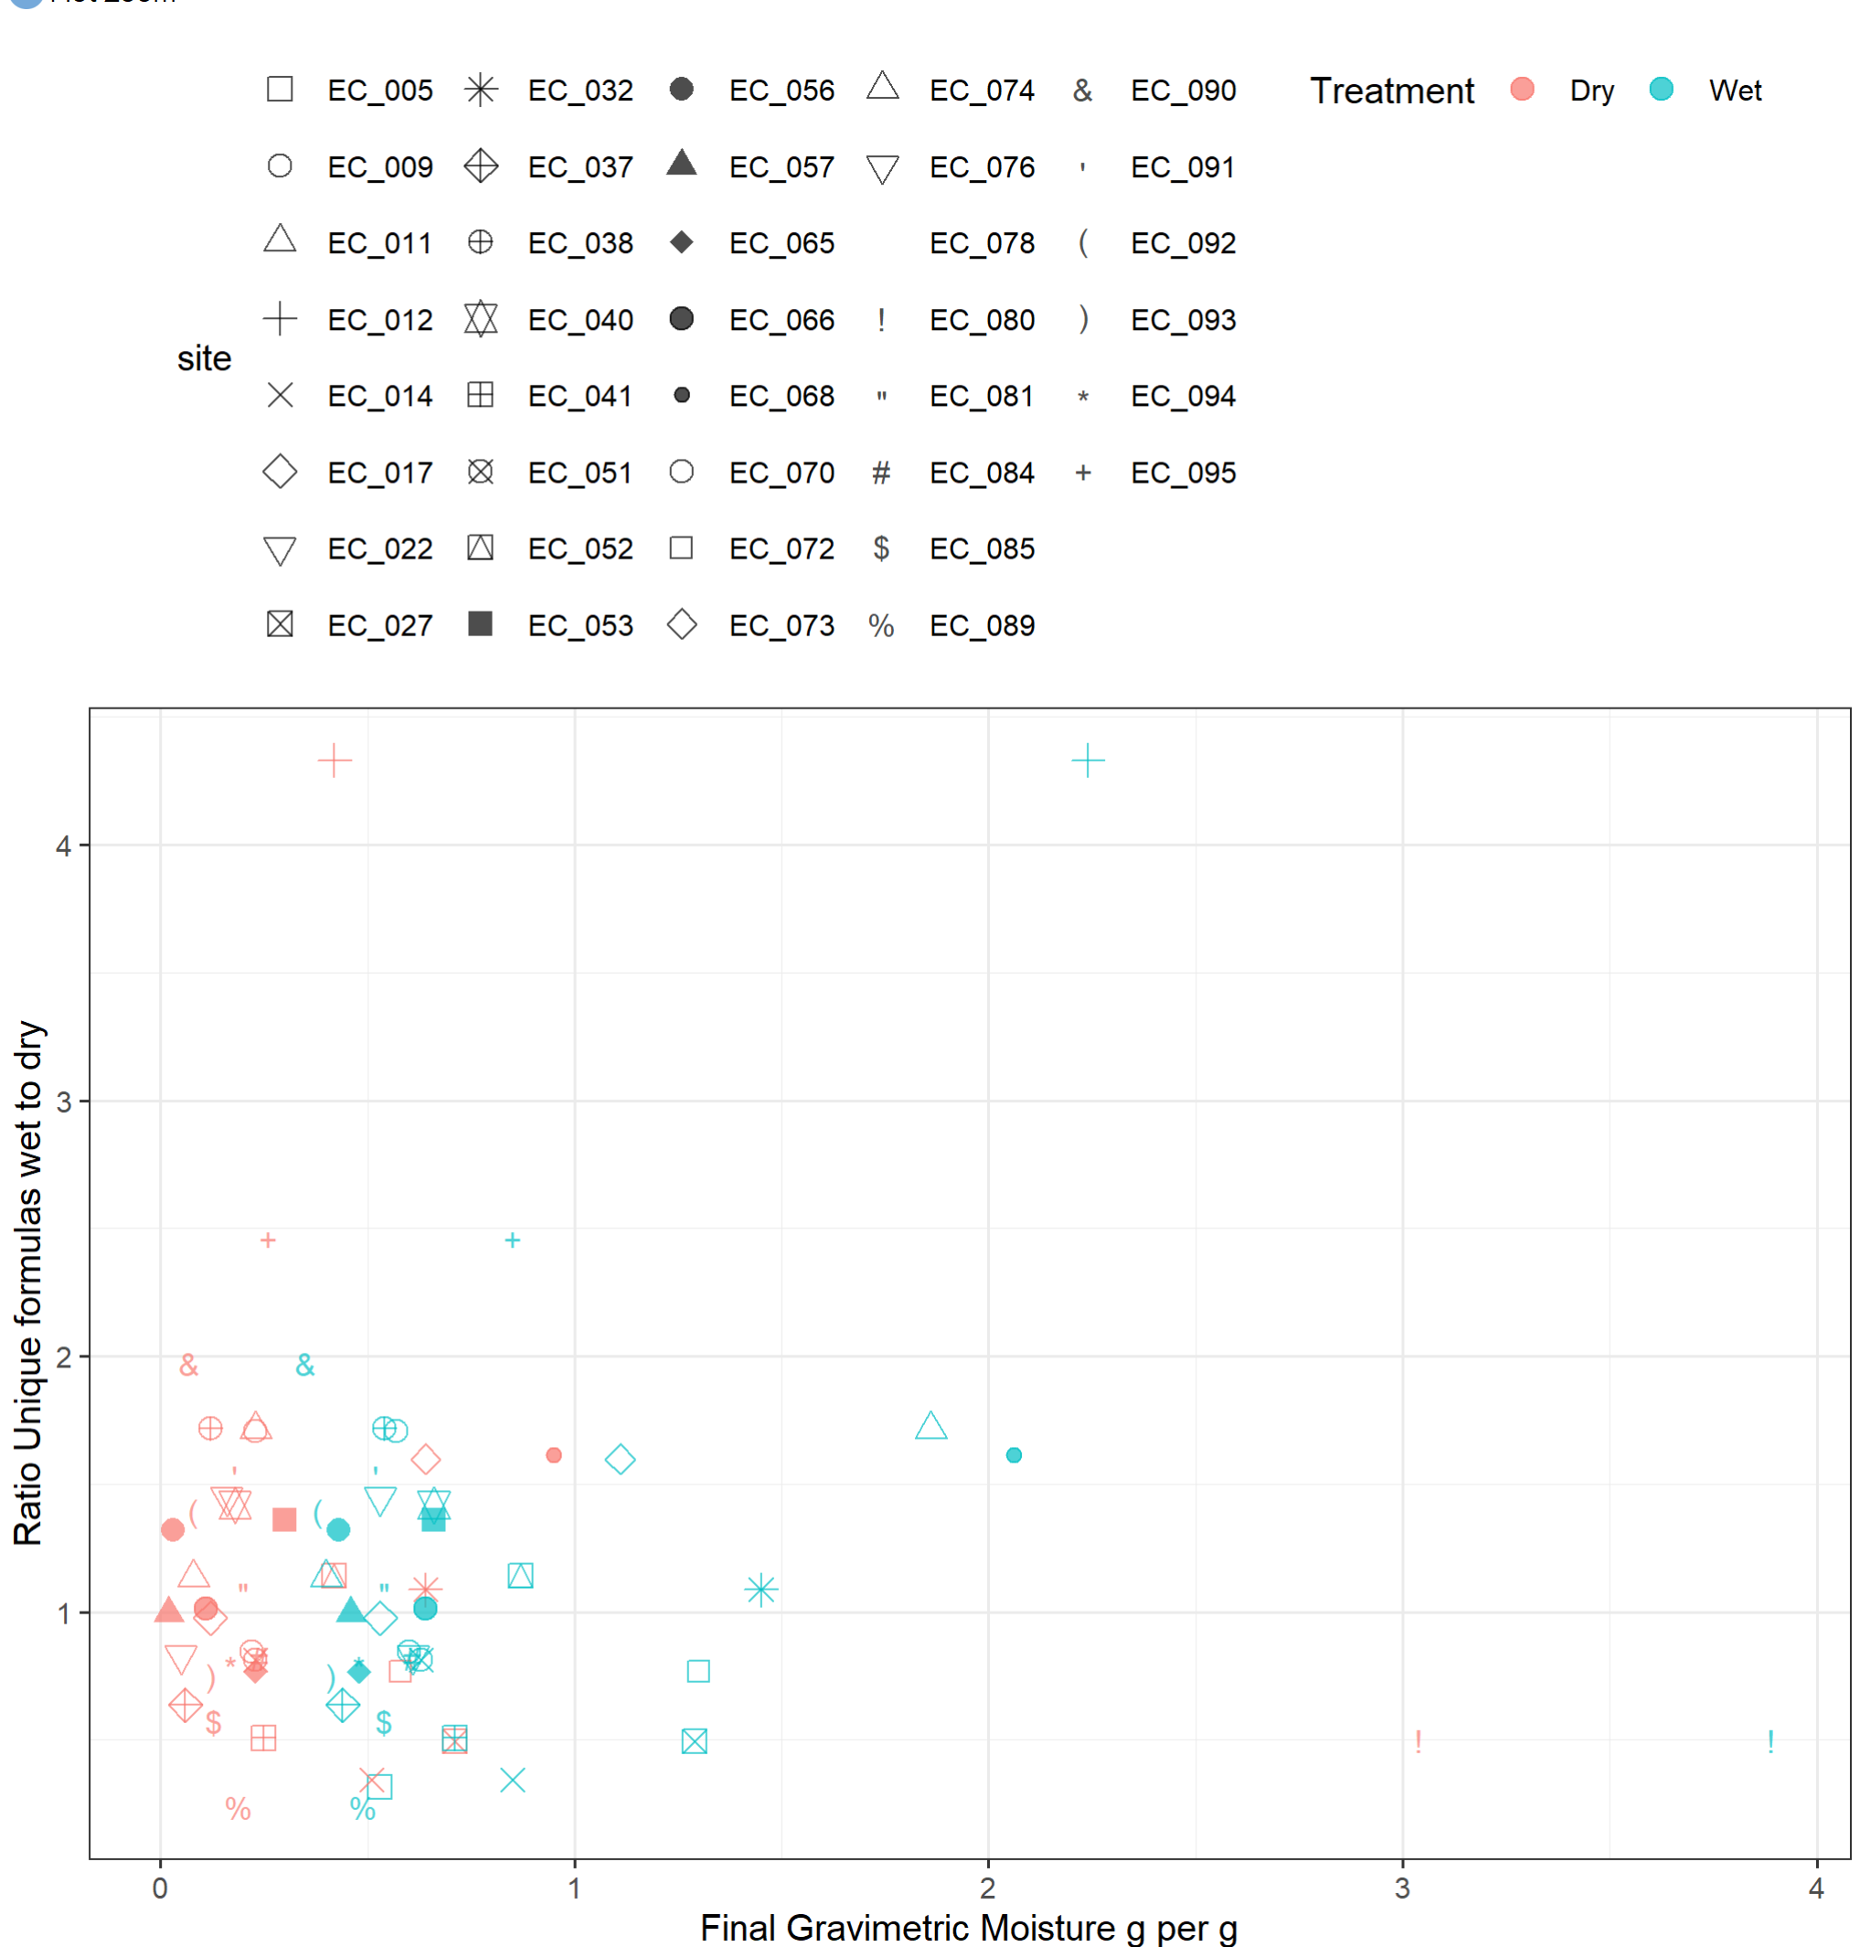

Slide 26
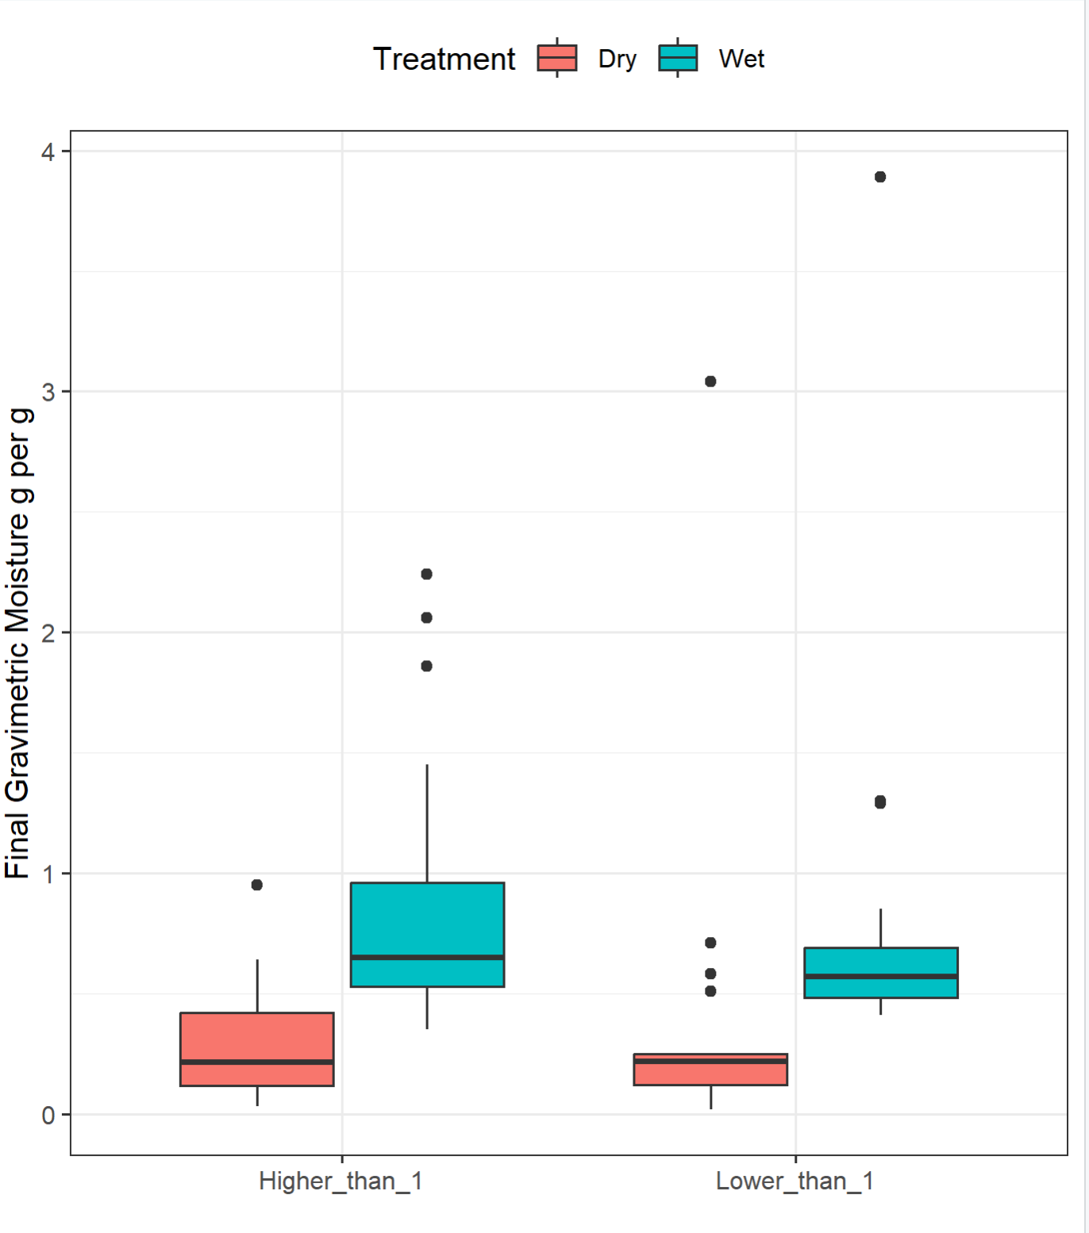
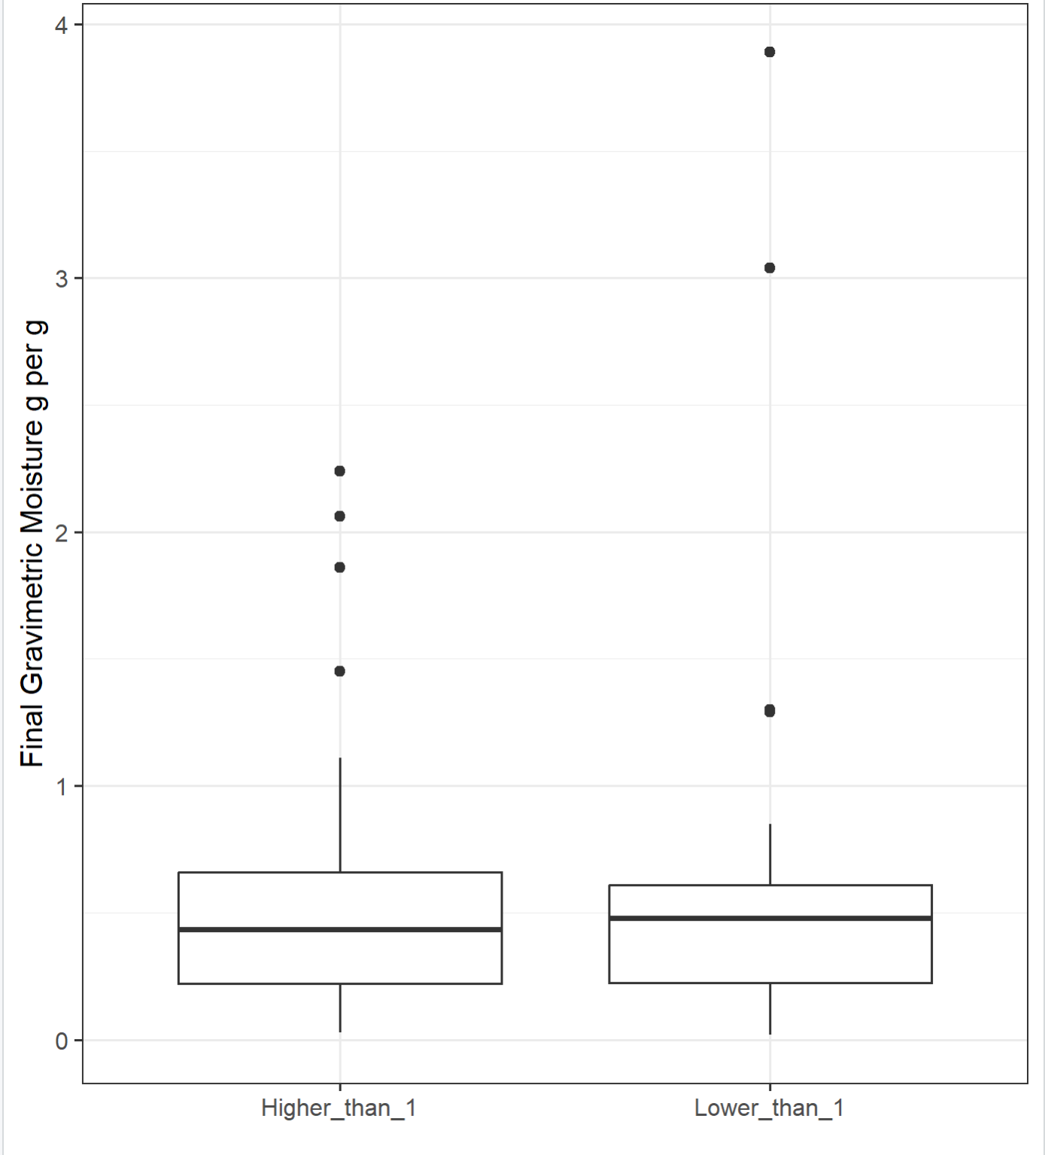

Slide 27
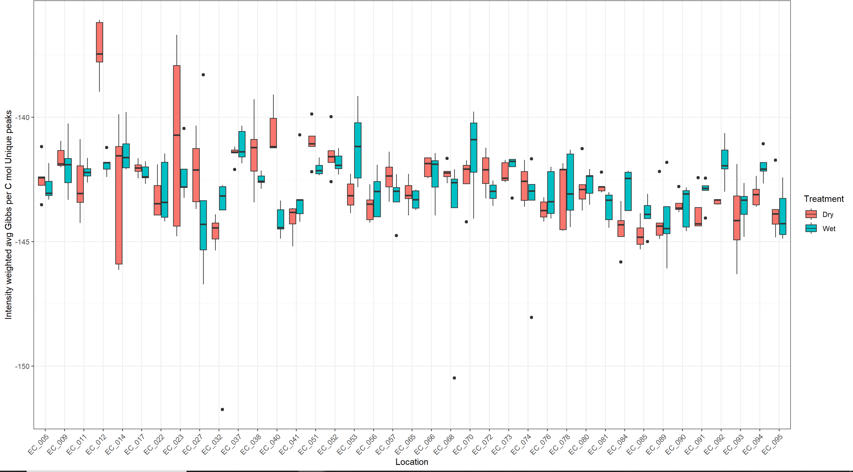

Slide 28
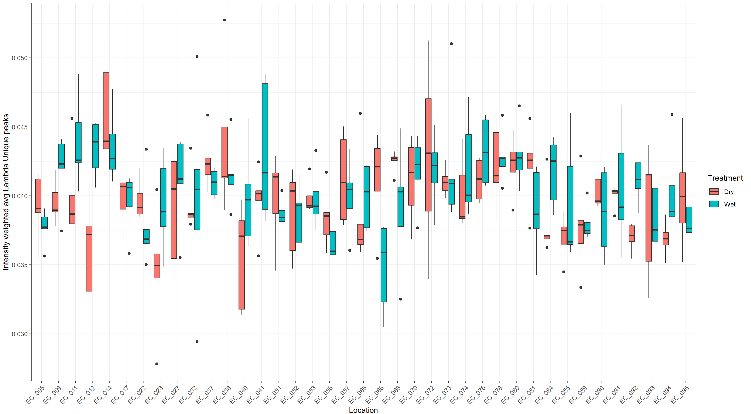

Slide 29
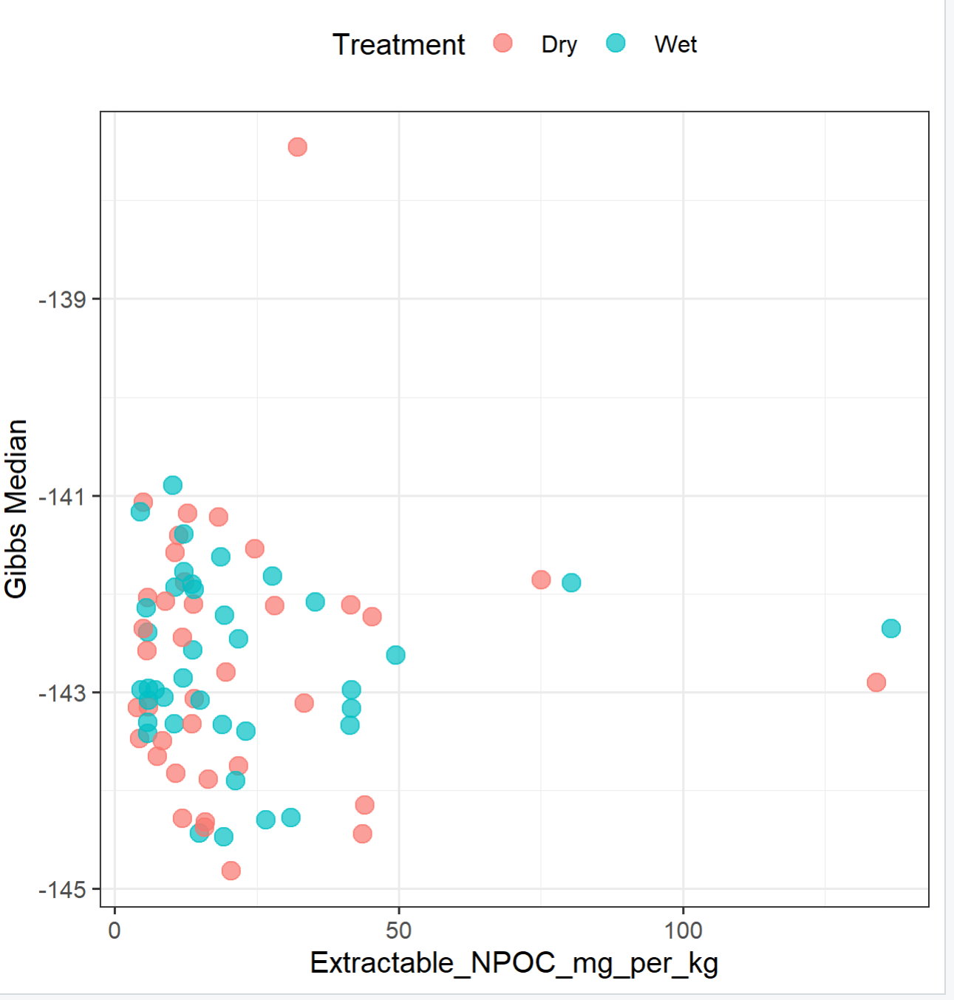
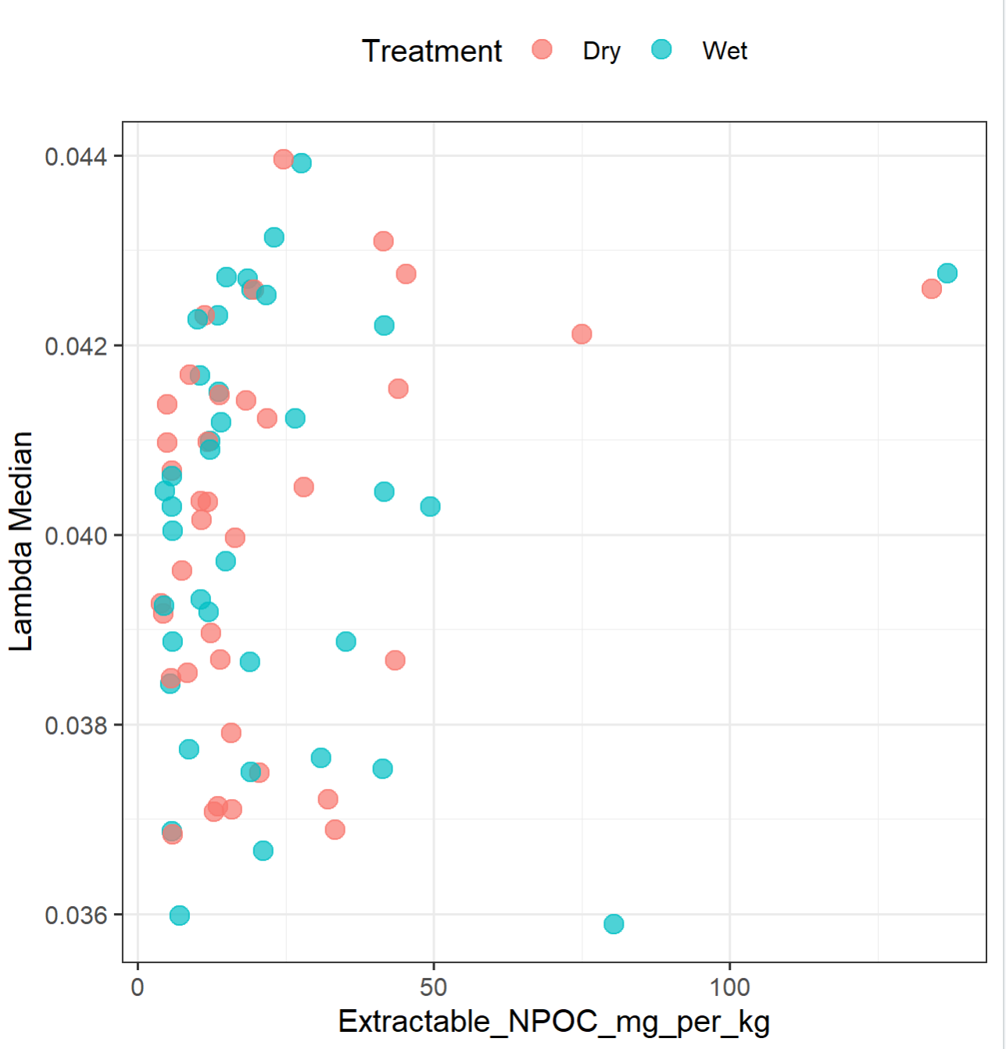

Slide 30
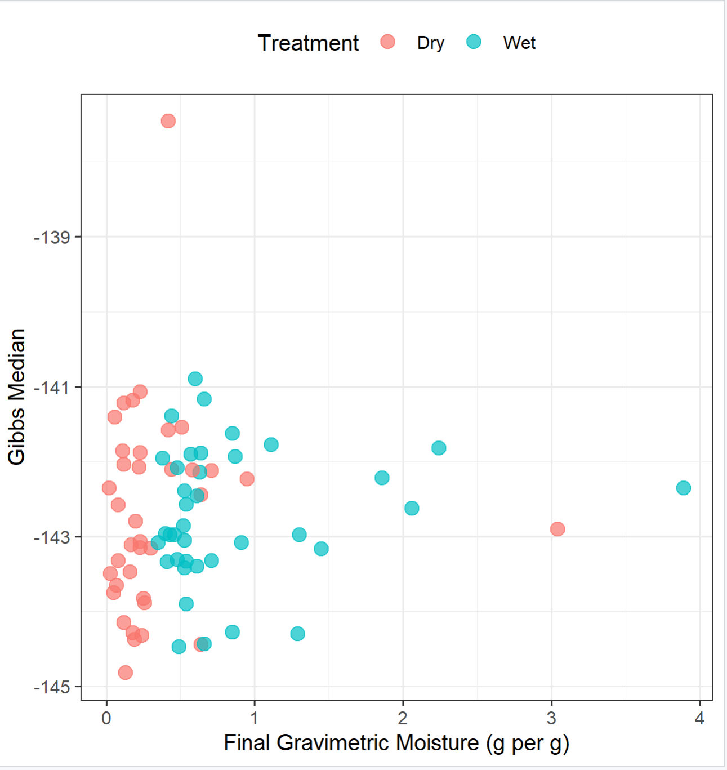
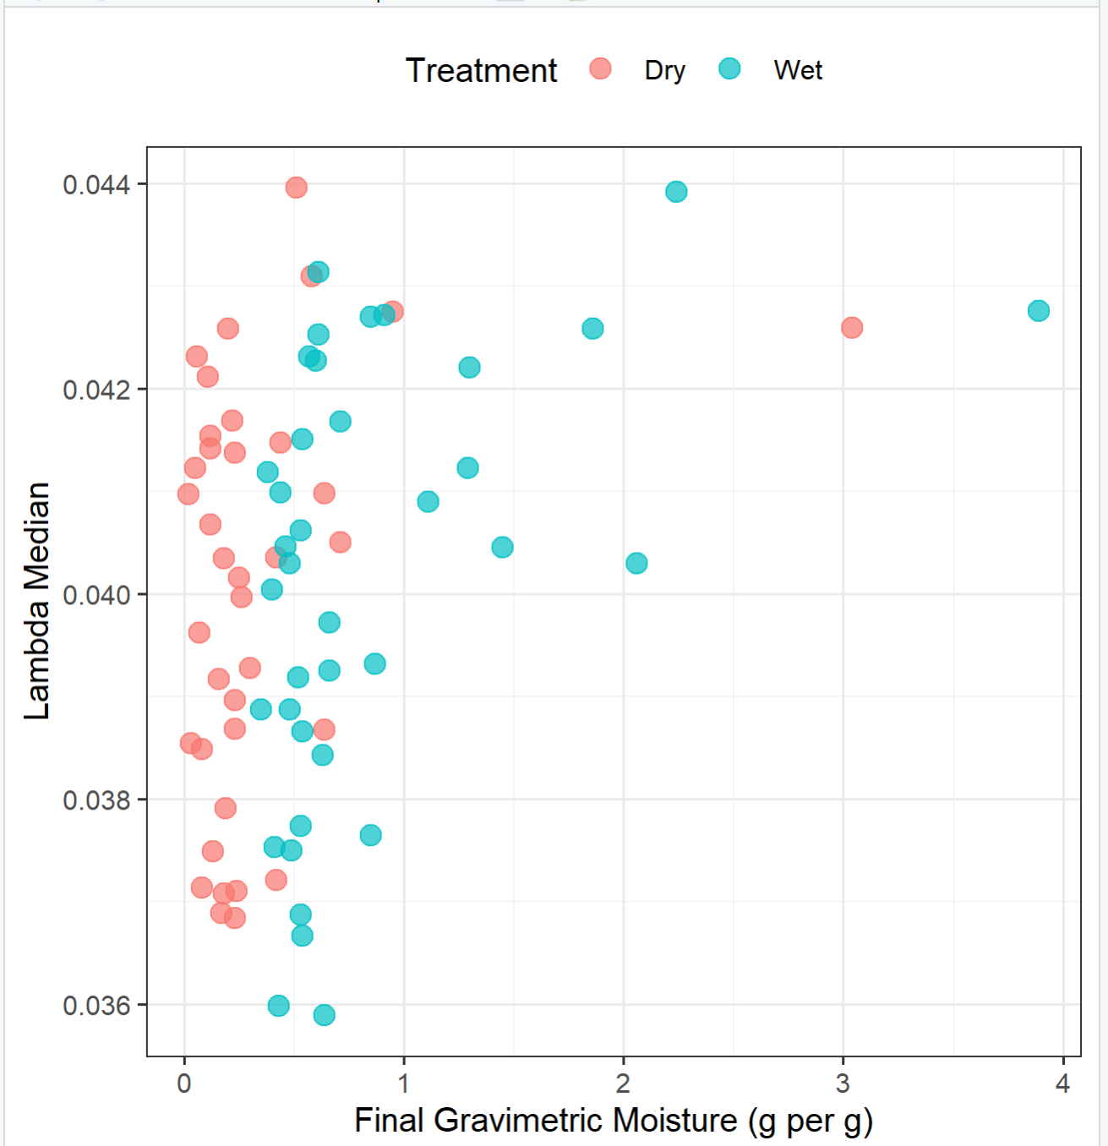

Slide 31
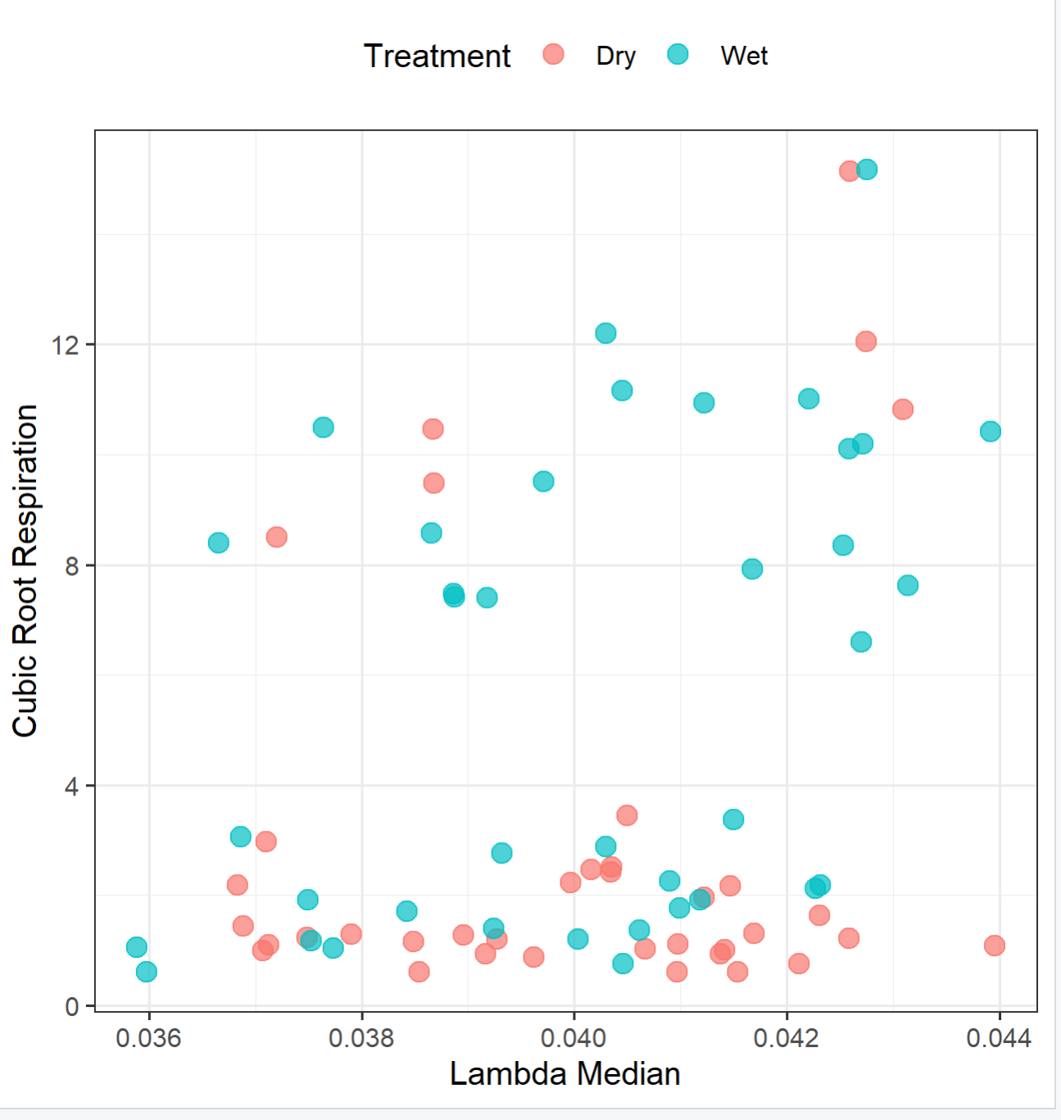
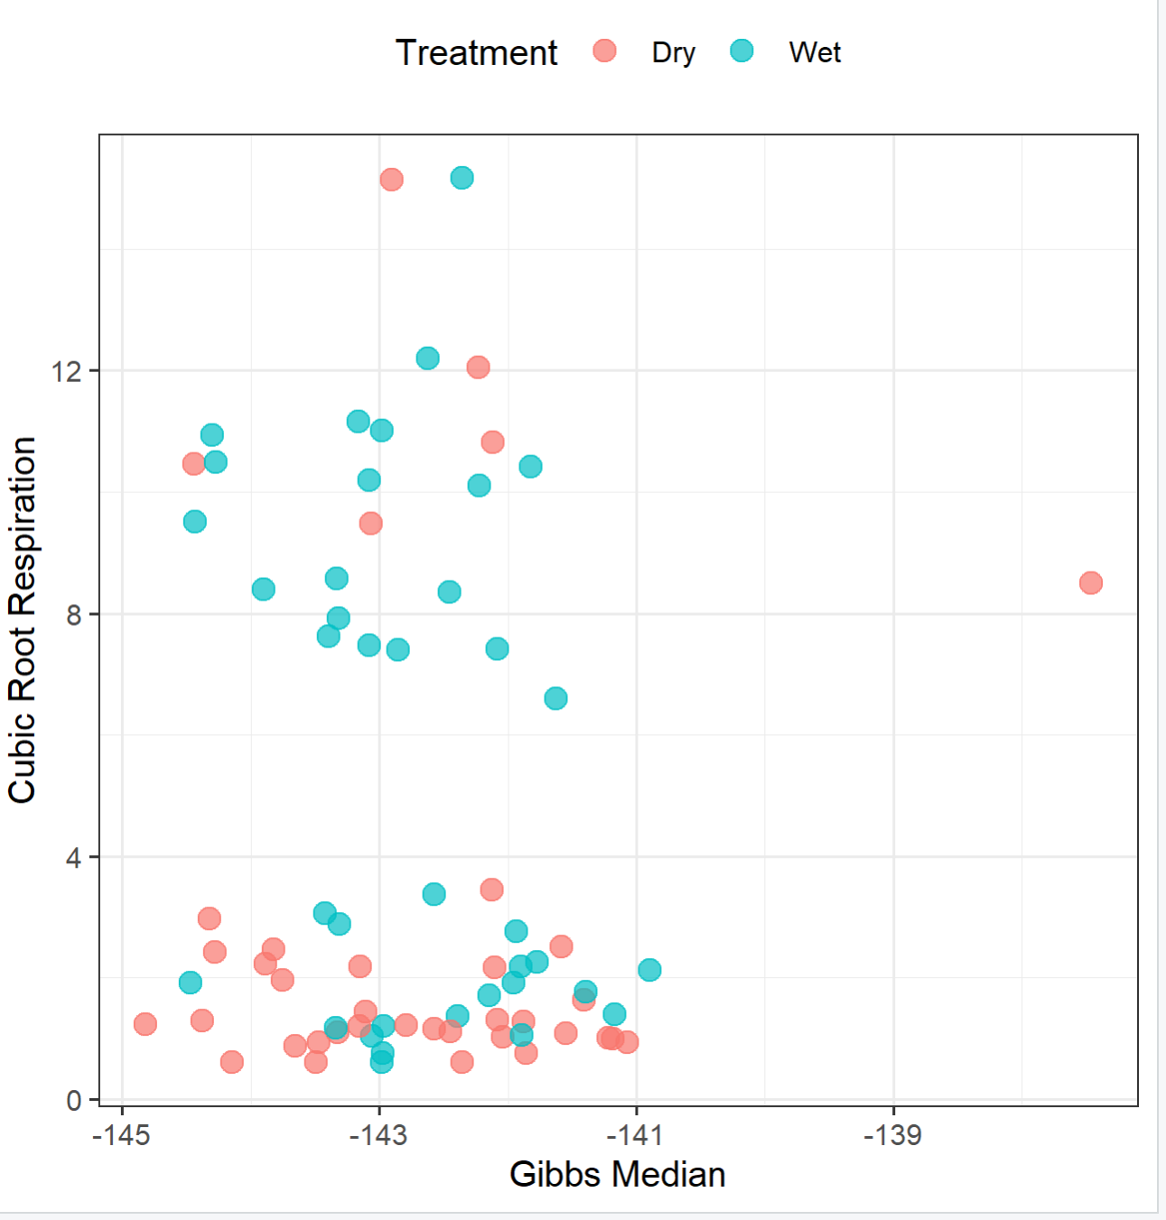

Slide 32
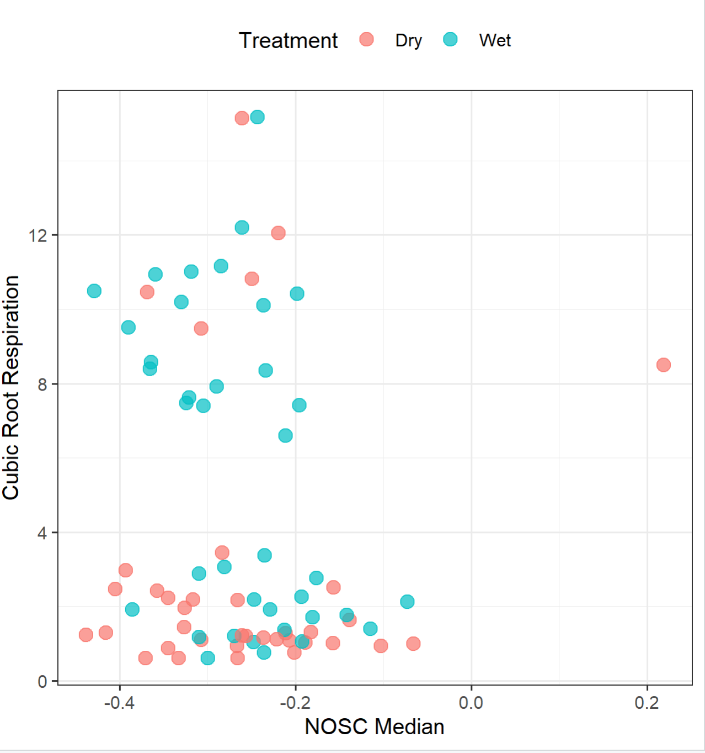
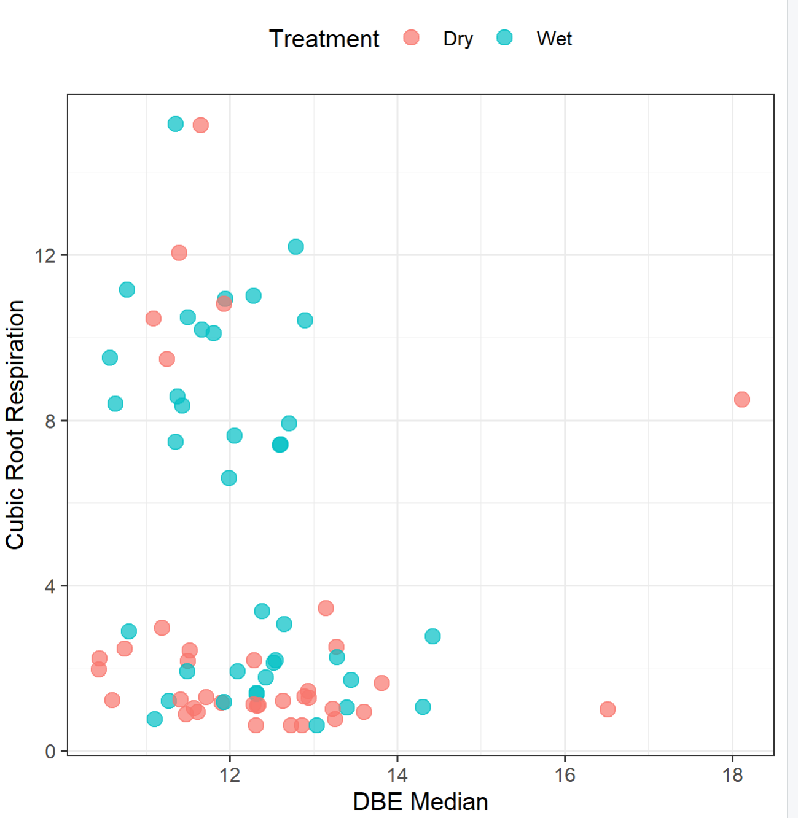
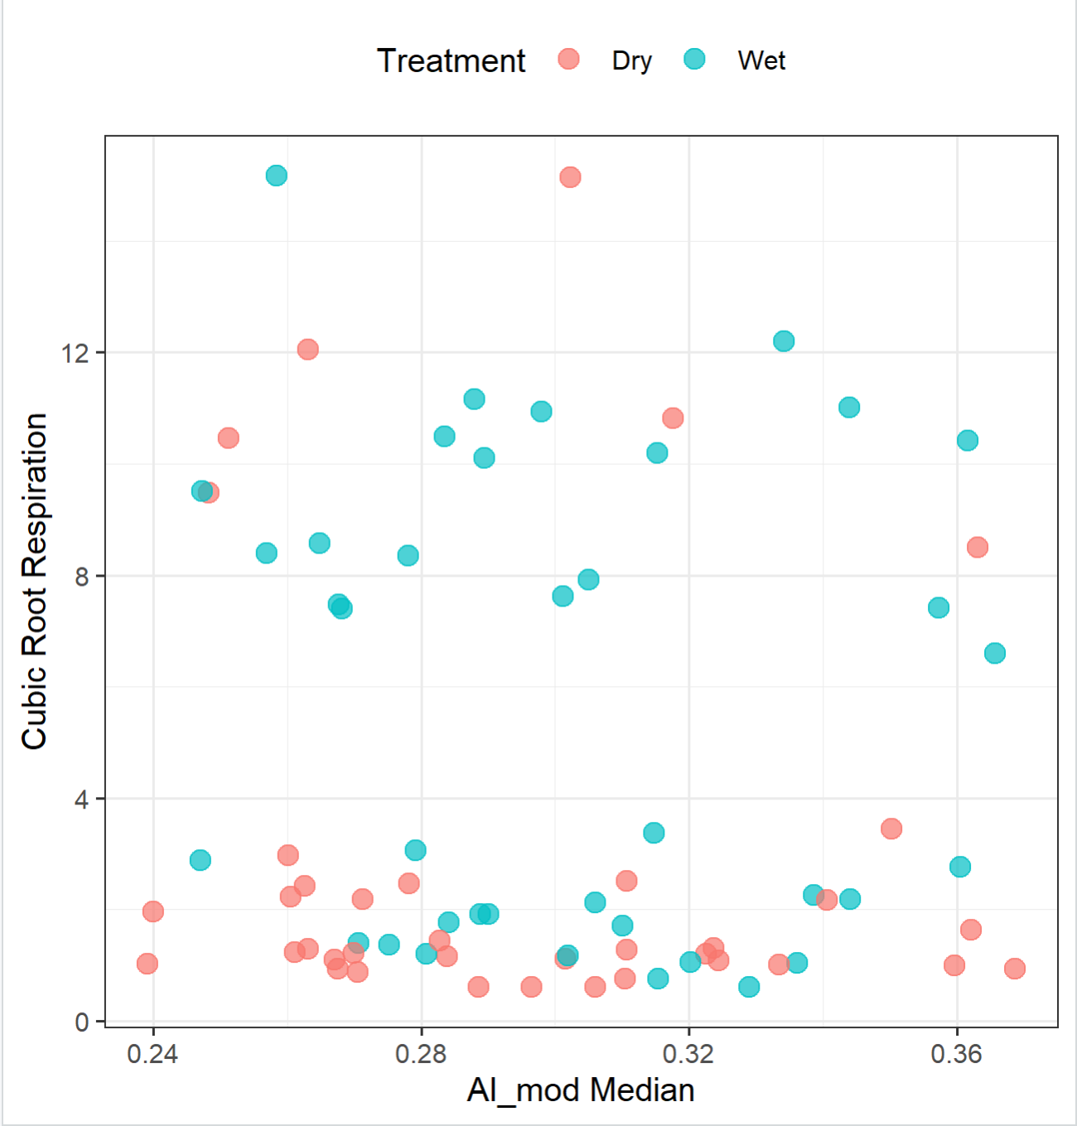

Slide 33
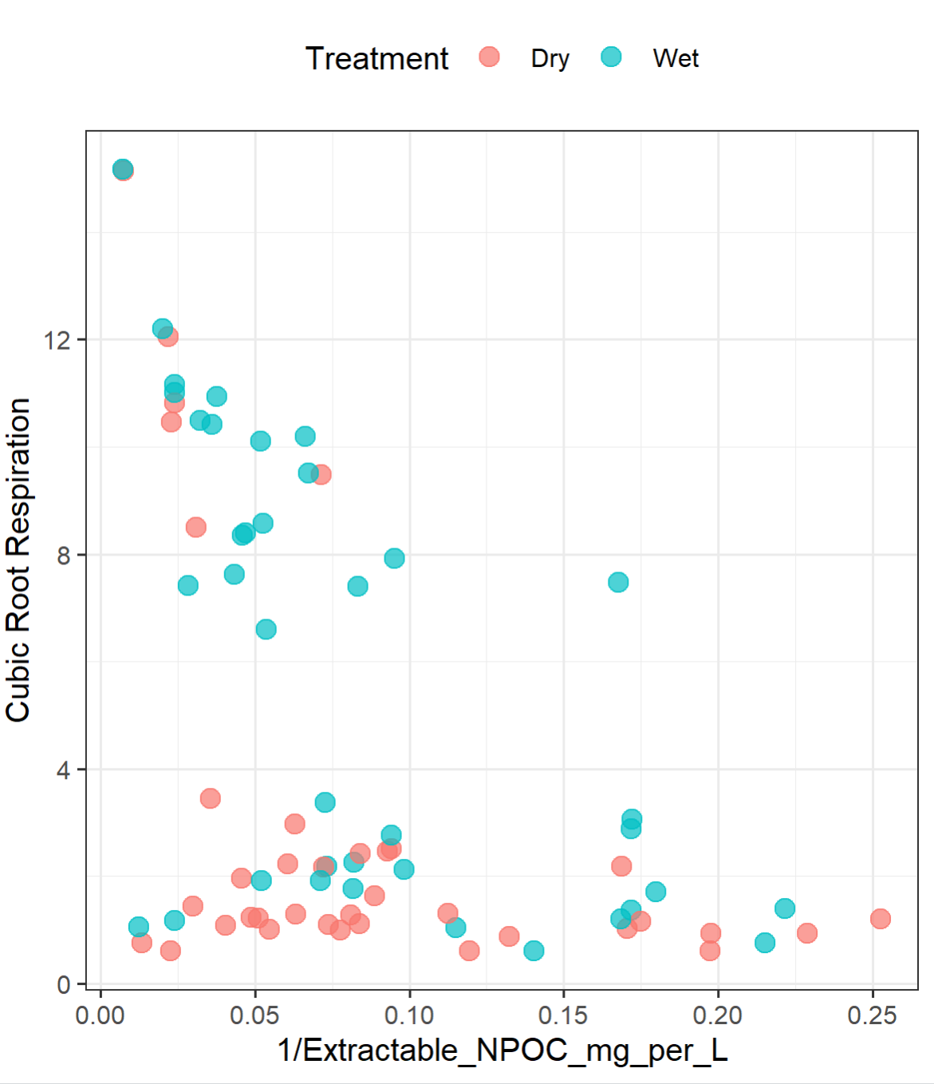
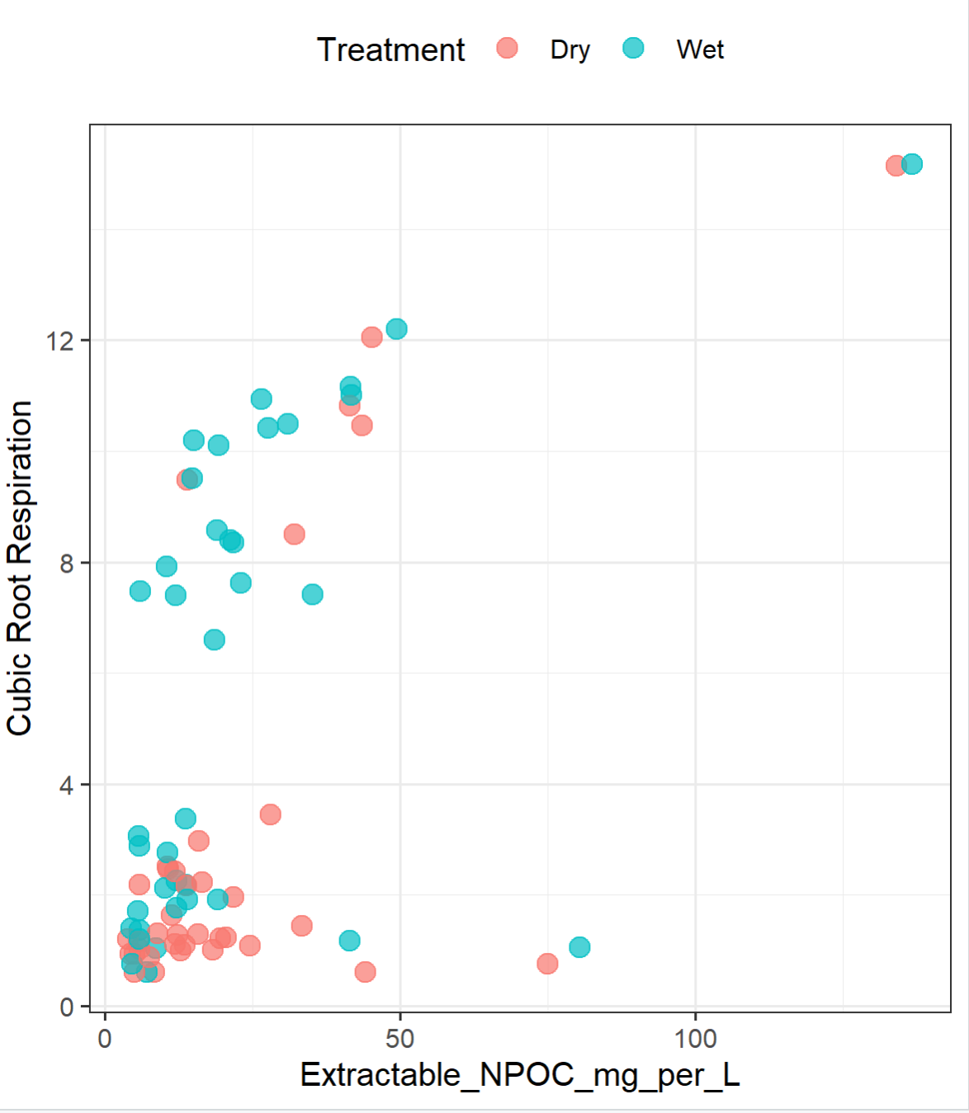

Slide 34



Slide 35


WGCNA Min module size of 20 block size of 26k

Slide 36



Slide 37

# 4. Identify the Principal Component with Maximum Treatment Separation # Calculate treatment means for each PCmean_diff <- colMeans(subset(pca_scores, treatment == "Wet")[, -ncol(pca_scores)]) - colMeans(subset(pca_scores, treatment == "Dry")[, -ncol(pca_scores)]) # Find the PC with the highest absolute mean differencemax_diff_pc <- names(which.max(abs(mean_diff))) # 5. Correlate Modules with the Principal Componentcorrelations <- sapply(colnames(moduleEigengenes), function(mod) { cor(moduleEigengenes[[mod]], pca_scores[[max_diff_pc]], method = "pearson")}) # Convert correlations to a data frame for visualizationcor_df <- data.frame(Module = names(correlations), Correlation = correlations)cor_df <- cor_df[order(-abs(cor_df$Correlation)), ] # 6. Visualize Correlation Strengthsggplot(cor_df, aes(x = reorder(Module, -abs(Correlation)), y = Correlation)) + geom_bar(stat = "identity", fill = "steelblue") + coord_flip() + theme_bw() + labs(title = paste("Module Correlations with", max_diff_pc), x = "Module", y = "Correlation Strength")

